Slide 1

Coordinated Entry/Assessment Training for Coordinated Entry System (CES)

Slide 2
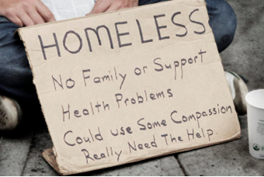
Agenda
Coordinated Entry System Overview
211 Collaboration & Access Sites
Engaging Individuals in a Homeless Crisis
Coordinated Assessment Tool Overview
Homeless Information System (HMIS) – How we use it.
Follow-Up and Next Steps
Case Conference Calls
Feedback on CA

Slide 3
Coming Home of Middlesex County
Coming Home manages Middlesex County's Homeless Management Information System (HMIS), providing real-time data for effective intervention. We oversee the County Coordinated Entry/Assessment System, ensuring uniform assessments and prioritizing resource allocation. This work streamlines assistance for those in housing crises often referred through 211, and our physical access sites for connections to essential support.
Our Physical Access Sites:
Unity Square Community Center 81 Remsen Avenue New Brunswick, Monday - Thursday| 9:00 AM - 4:00 PM
Reformed Church of Highland Park 19 S 2nd Avenue Highland Park, Tuesdays | 2:00 PM - 4:00 PM
First Presbyterian Church of Metuchen 270 Woodbridge Avenue Metuchen, Thursdays | 9:00 AM - 11:30 AM
Center for Support, Success & Prosperity 392 Smith Street Perth Amboy, Monday - Friday | 9:00 AM - 5:00 PM
Middlesex College Community Resource Hub & Food Pantry Room CC 170 A, 2600 Woodbridge Avenue Edison, Thursdays | 12:00 PM - 5:00 PM

Slide 4
What is 211?
NJ211 is a statewide free and confidential information and referral service that connects people with important community resources and assistance. It serves as a comprehensive helpline for individuals seeking health and human services information. Assistance is offered 24/7 hours a day 365 days in 150 languages.
Services Provided:
Housing assistance resources
Food assistance programs
Mental health and substance abuse support
Healthcare Resources
Employment and education services
Utility assistance
Support for seniors and people with disabilities
Disaster response and recovery information
Accessing 211:
Dial 2-1-1 or call 1-877-652-1148
Text the zip code to 898-211
Live chat and Search the Database at www.nj211.org
Email at info@nj211.org,

Slide 5
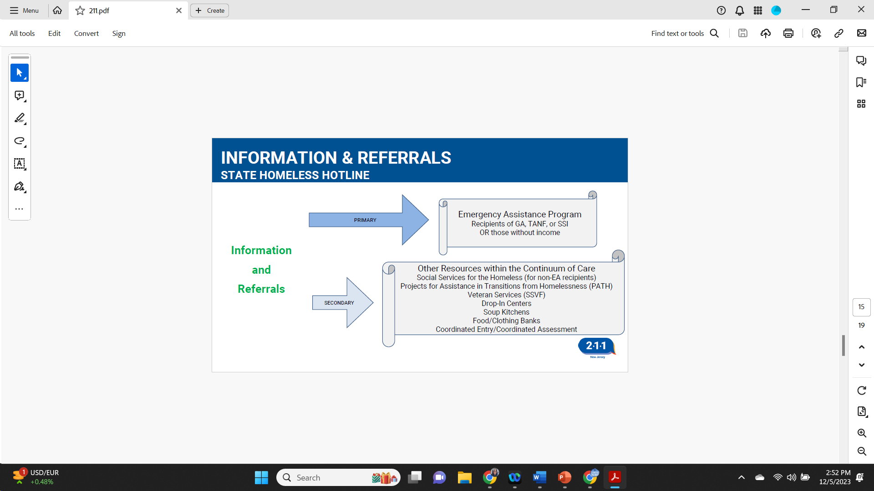
211 is also NJ’s Homeless Hotline
211 Operator will provide a referral to Coming Home via a direct voicemail line.
Coming Home CES Team will check voicemail daily and return the call within 24 -48 hrs.

Slide 6
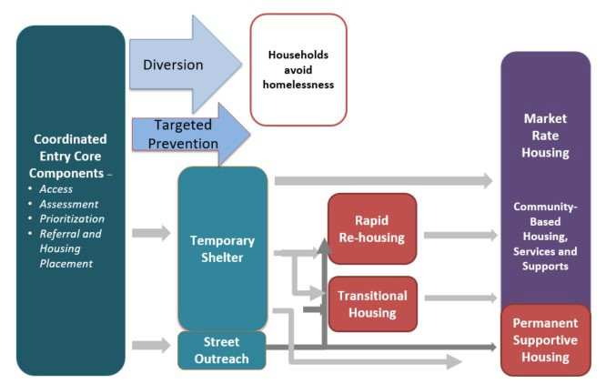
Coordinated Entry System Overview
Coordinated Entry is a centralized process for individuals and families facing a housing crisis. Coming Home streamlines intake and service referrals to ensure cohesion within the Continuum of Care (CoC).
Key features of the system include:
A thorough and standardized assessment for holistic participant evaluation.
Prioritizes individuals and families for available housing and support resources.
Emphasizes partner collaboration to enhance process effectiveness.

Slide 7
Key Objectives of the CEA
Increased Efficiency:
Streamline the response to housing-related crisis for quicker and more effective outcomes.
Improved Fairness:
Ensure fairness in addressing the needs of clients in crisis situations.
Enhanced Access:
Increase the ease of access to services and resources for clients facing housing-related challenges.
Flexibility:
Design the system to be adaptable to various crisis scenarios.
Regular Revisitation:
Establish a framework for the periodic review and optimization of the coordinated entry system.
.
Driving Change Using Data:
Use data collection to strengthen our response to homelessness. Identify gaps and needs and strategically advocate for programs and enhanced community support.

Slide 8
The Coordinated Assessment Tool
The Coordinated Assessment Tool is used to Assess and Prioritize Individuals/Families experiencing HUD Homelessness. The Assessment is used to determine the appropriate housing solution for the homeless individual/family.
Clients are Prioritized for housing solutions based on their length of homelessness and the severity of their needs.
Clients are Referred for a housing resource based on their prioritization and other eligibility criteria once a resource becomes available.
Who should complete it?:
The client may NOT fill out their own CA!
Emergency shelter staff
Case manager
Social worker
DCP&P case worker
MCBOSS
For whom should it be completed?:
The individual/family in a place not meant for habitation
Those in a motel placement paid for by agency/church
The individual/family in a shelter
HUD Homeless criteria on slide 9

Slide 9
Types of HUD Homelessness
Literally Homeless | Lack of a fixed, regular, and adequate nighttime residence. Includes living in places not meant for habitation, shelters, or temporary residence in emergency shelters or institutions for under 90 days. Immediate pre-institutional residence in emergency shelters or places not meant for habitation is also encompassed in this definition.
Imminent Risk of Homelessness | Individuals or families facing imminent loss of their primary nighttime residence. Conditions include potential loss within 14 days, absence of an identified subsequent residence, and lack of resources or support networks for obtaining permanent housing..
Homeless Youth and Families | Unaccompanied youth under 25 or families with children not meeting the primary homeless definition. Qualifications include alignment with federal homelessness statutes, absence of permanent housing for 60 days, experiencing persistent instability with two or more moves in the last 60 days, and anticipating prolonged instability due to special needs or barriers.
Fleeing/ Attempting to Flee DV | Any individual or family who: Is fleeing, or is attempting to flee, domestic violence; Has no other residence; and Lacks the resources or support networks to obtain other permanent housing

Slide 10
Chronic Homelessness Criteria
• Must have a qualifying disability.
• Living in a place not meant for human habitation or emergency shelter.
• Has been homeless for a year or has experienced four episodes of homelessness in the past three years, adding up to one year.
• “Episodes of homelessness” are instances separated by a break of at least 7 nights.

Slide 11
Administering the Assessment
All answers must be true for today.
Provide all information requested
Include all information for entire household
Be sure to include your contact information
Keep in mind that this is NOT a housing application.
Keep in mind that this is NOT a guarantee of assistance.

Slide 12
Cover Page
This page should be completed in its entirety. Anything left blank could delay next steps.
Date – this should be the date you completed the Assessment. If the client returns 6months or more later, you need to complete a NEW Coordinated Assessment. Please send it right away.
Name –the Head of the Household (your client).
Additional Household Members – everyone in that person’s household should be listed. Their partner, children, whoever will be living with them when assistance is provided. If they have children they will regain custody of, note that in the email.
If you are unsure, reach out to the Coordinated Assessment Team.

Slide 13
Understanding Questions & Answer Choices
These Questions MUST align with the Homeless History
Questions #1 & #3 – these answers cannot be the same:
#1 - Living Situation - Where did you sleep last night?
- To be considered HUD Homeless, answer options #1 or #2 need to be selected. Any other selections will result in rejection.
- Answer options #2 & #11 – these are not the same answer. Who is paying for the hotel/motel?
a. Emergency Shelter including hotel/motel paid w/ emergency shelter voucher.
b. Hotel or motel paid for without emergency shelter voucher (self-paying).
#2 – How long have you been staying there?
#3 – Residence Prior to last night - Where were you staying before that?

Slide 14
Asking for the client's Homeless History
"Your time is valuable, and I appreciate you sharing your experiences. Can you tell me about any difficulties you've faced in the past finding stable housing? Understanding your history will help us tailor our assistance to your needs.“

Slide 15
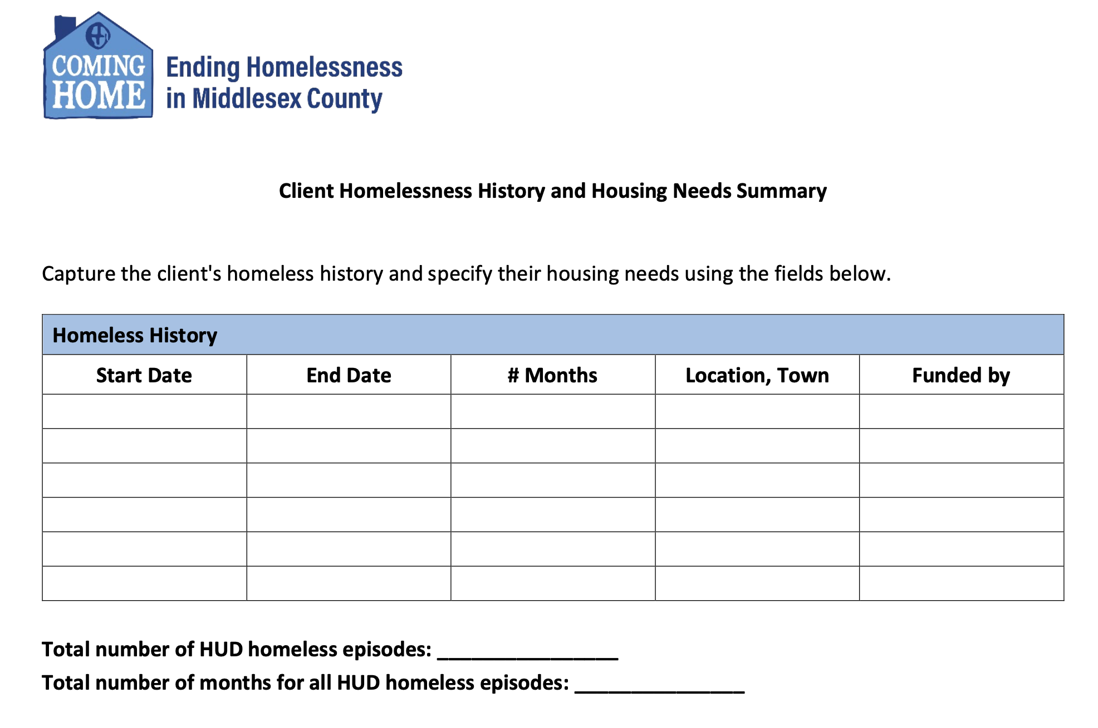
Understanding Questions & Answer Choices
Question #5 – Episodes
Even though the form says, “Homeless History”, we need 3 years of housing & homeless history to properly account for episodes of homelessness.
Please DO NOT put each day they changed locations. This does not equal a full episode.
Literal location & town
Who paid for it?

Slide 16
Examples

Slide 17
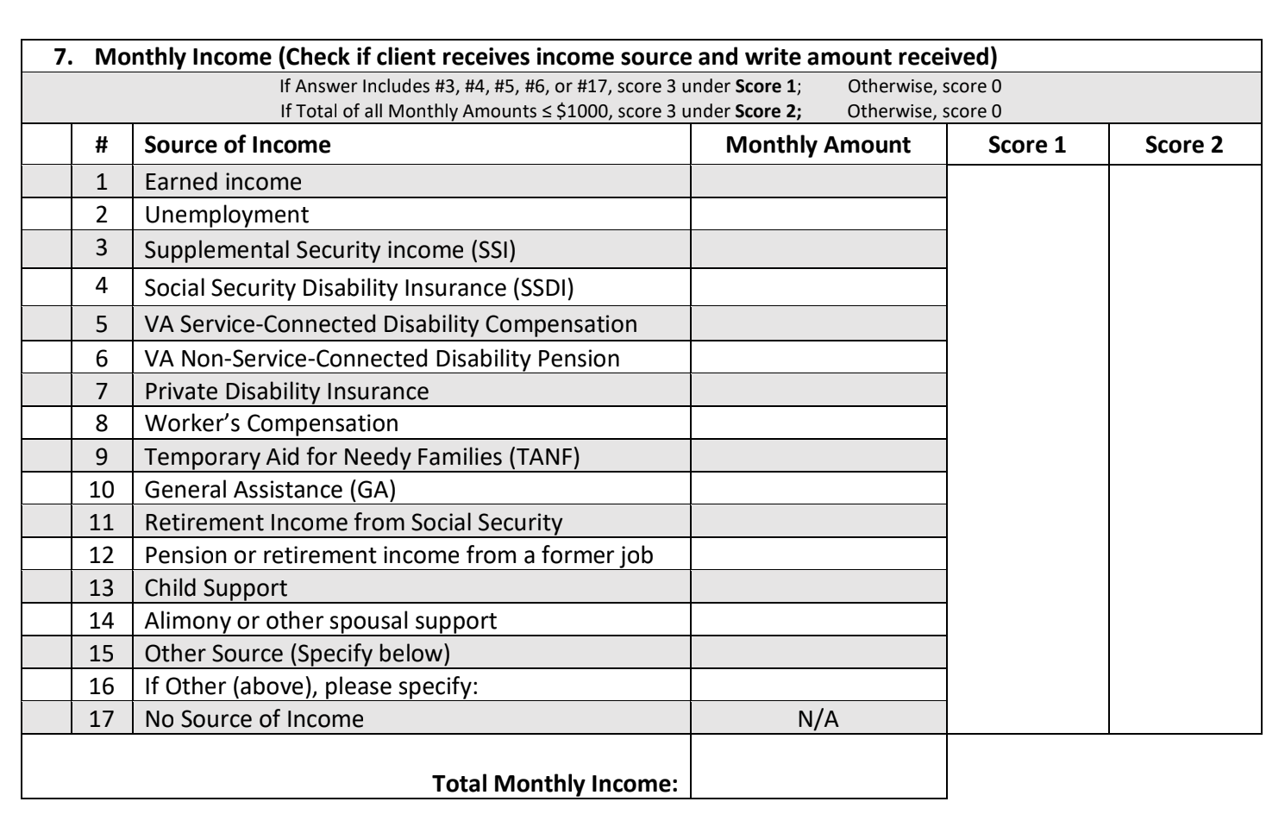
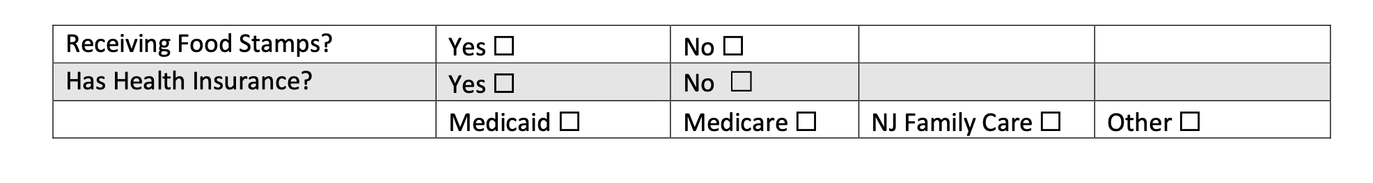
Understanding Questions & Answer Choices
Question #7– types of income:

Slide 18
Tips for Income Calculations
Use exact numbers. Never guestimate!
Calculate using Gross numbers
Is this person paid weekly, bi-weekly, once a month? Hourly or salarly?
What is actually received vs what they’re supposed to get.
Confirm sources:
Be sure to put the total. If you’re unsure, ask the CA Team.
SNAP/Food Stamps is not income. ONLY the cash is income.

Slide 19
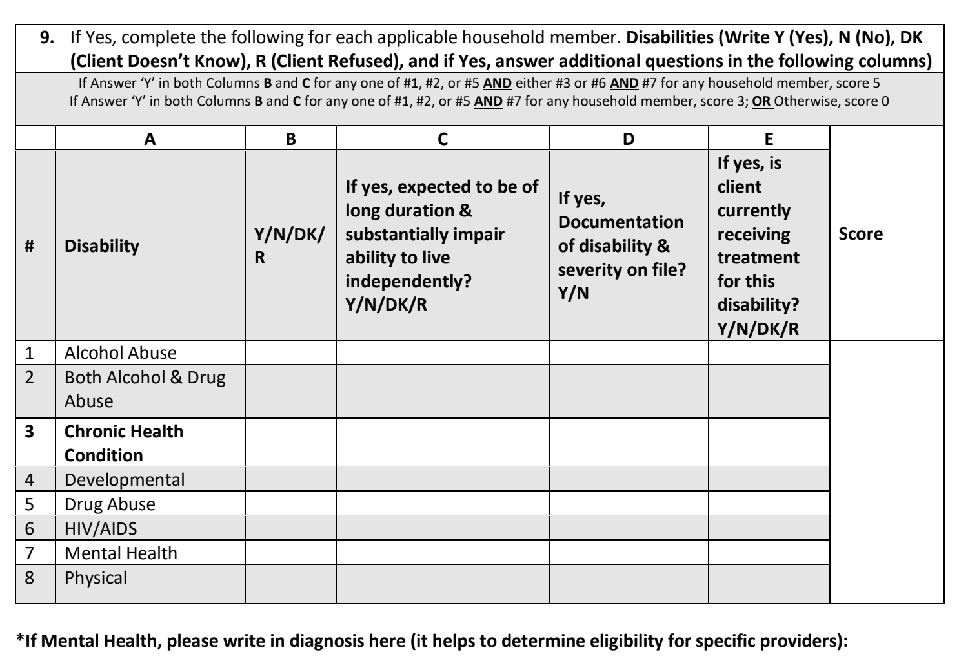
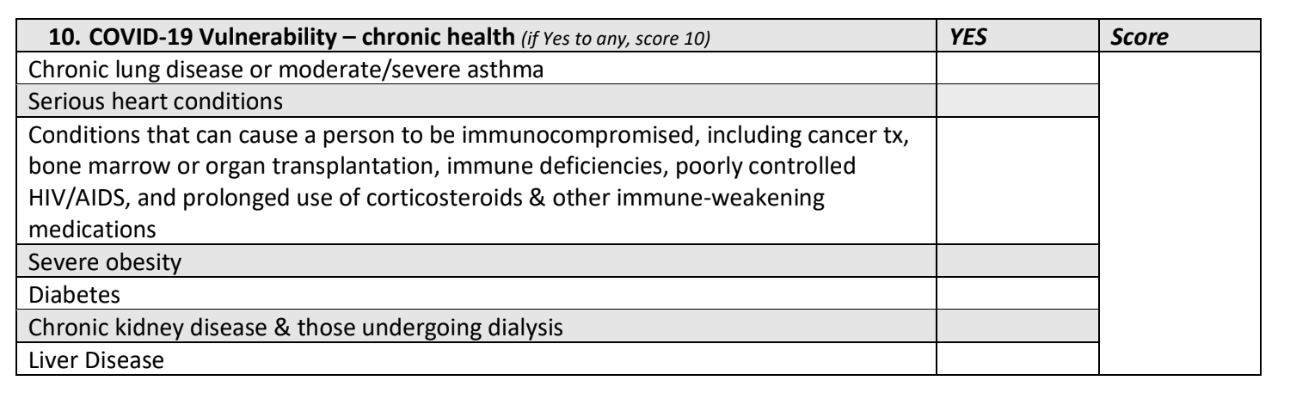
Understanding Questions & Answer Choices
Question #8, 9 & 10– disabilities:
Always list the diagnosis. This can be crucial for certain referrals.

Slide 20
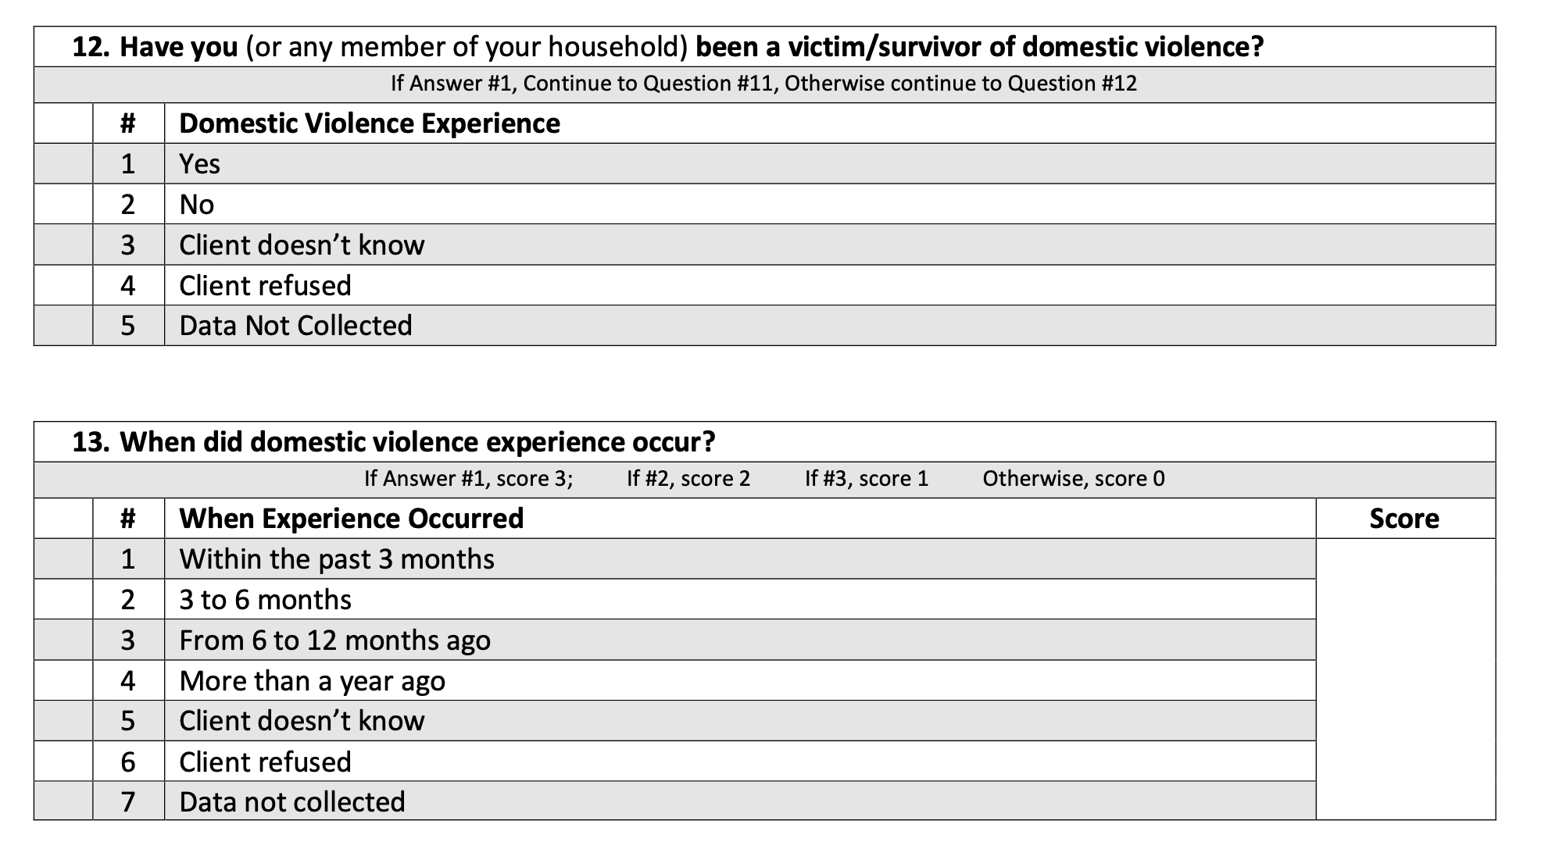
Understanding Questions & Answer Choices
Question #12 & 13– Domestic Violence:

Slide 21
Understanding Questions & Answer Choices
Question #14- interaction with police & incarceration:
Be truthful. If client is awaiting sentencing, or if they are on parole/probation, give us a heads up. This is something that could limit eligibility.
Question #15- Emergency Room visits & hospitalizations:
Be truthful. Severe medical conditions should be noted with the chronic health questions.
Question #16- psychiatric & mental health facilities:
Be truthful.

Slide 22
Understanding Questions & Answer Choices
Question #17– Chronic Homelessness:
The CEA Team will make this determination and mark it appropriately. DO NOT answer this question.
Scoring:
DO NOT score the Assessment. The CEA Team will score and send you that information.

Slide 23
Next Steps: after submitting a Coordinated Assessment Form
Email the completed Assessment to coordinated.assessment@co.Middlesex.nj.us
The CEA Team will review & score the Assessment. The Score & Summary will be sent to the case manager(s).
Next Steps will be noted on the Summary. Client will be added to the By-Name-List (BNL)
Client will be referred for a housing opportunity or resource when available based on eligibility criteria.
Label the Coordinated Assessment. For example: J. Doe

Slide 24
Next Steps – when an opportunity arises
Timing is critical. When a housing opportunity presents itself, you and the individual/family you are working with MUST be “ready to go”.
Ready to go:
Birth Certificates (for all Household members)
Social Security Cards (for all Household members)
Paystubs (at least 2 months worth)
SS Award letter
TANF/GA Award letter
Bank Statements (at least 2-3 months worth
Basic supporting documents are listed at the end of the CA packet

Slide 25
Next Steps – when an opportunity arises
Timing is critical. When a housing opportunity presents itself, you and the individual/family you are working with MUST be “ready to go”.
Ready to go:
CA Team will reach out to you to collect more information & discuss possible opportunity.
CA Team will review eligibility criteria with you.
CA Team will draft referral & email it to the provider (landlord or property manager) with you & all other appropriate staff copied.
You are responsible for assisting the client with submitting the application and supporting documents as well as getting to the appointments with the property

Slide 26
Next Steps – when an opportunity arises
Timing is critical. When a housing opportunity presents itself, you and the individual/family you are working with MUST be “ready to go”.
Ready to go:
This email is NOT to be forwarded to the client. YOU ARE to assist them.
This opportunity is NOT guaranteed. They still need to complete the application process.
If/when approved, assist with locating a Security Deposit. CA Team will refer if funds are available through other programs.
Consistently attend Case Conference Calls to discuss cases. The community can/should work together for resources.

Slide 27
Problem Solving – What to Consider
Does the individual have a chronic disability?
Does the individual have youth dependents or dependents that have chronic disabling conditions?
If the individual is couch surfing, have they been provided a date they must move, or is the stay infinite?
Has the individual sought out other resources AND followed up on them?
Does the individual have a current housing voucher?
Does the individual have income support from family members?
What is the individual’s current mental health condition?

Slide 28
Types of Referrals
Referrals are made to individuals after a full intake has been completed. Some of the main referrals we provide are below but are not limited to these options.
RRH – Rapid Re-Housing
PSH – Permanent Supportive Housing
OPH – Other Permanent Housing
TRA – Temporary Rental Assistance (MCBOSS)

Slide 29
Referrals - Rapid Re-Housing
Rapid Re-Housing (RRH) is a short-term financial assistance program for individuals and families who are HUD Homeless. Referrals MUST be submitted by the CA Team. These individuals/families are HUD Homeless, have income, are ineligible for MCBOSS and will be able to increase their income to become self-sufficient.
Types of Financial Assistance include:
Short Term Rental Assistance
Security Deposits
1st Month’s Rent

Slide 30
Referrals – Permanent Supportive Housing
Permanent Supportive Housing is housing with supports in place. This could include, but is not limited to, a case manager on site to provide services. This property will have case management provided. Individuals/Families referred to these units MUST meet the HUD Definition of Chronic Homelessness. These units usually have a subsidy attached.
Types of services include:
Group activities (to form community)
Connection to Mental Health Services
Help recertifying for SNAP, Medicaid, lease renewal, etc.
On-site pantry

Slide 31
Referrals – Other Permanent Housing
Other Permanent Housing is the opposite of PSH. These are apartments/rooms without supports in place. These properties are unlikely to have any supports in place. Individuals/families referred to these units can live independently.

Slide 32
Housing Support Team
The Housing Support Team consists of a Property Engager and Housing Placement Liaison.
The Property Engager will build, maintain and keep current inventory of low barrier housing units of all sizes and landlords agreeing to rent to clients of MCHC3 agencies.
The Housing Placement Liaison (HP Liaison) will receive referrals from Agency Case Managers of clients who have gone through the Coordinated Assessment system and been approved for rental assistance or have the ability to self-pay. The referral will include a listing of the client’s needs and wants. The HP Liaison will review the Client Agreement with the client and obtain his/her signature. The Housing Support Team will identify available units appropriate for the client. If no such units are available in the inventory, the Property Engager must make best efforts to find additional units that match the client’s needs.

Slide 33
Connecting with the Coordinated Assessment Team
The Housing Support Team or Agency Case Manager should include the Coordinated Assessment Team on correspondence for the referral to the HST.
Agency Case Managers should confirm with the CA Team that Coordinated Assessment has been received and is still active for the client they need to refer. If not, they need to submit one that is true for today. If yes, submit the referral and copy the CA Team on the email
If the HST receives a referral and is not sure the client has an active CA, they should reach out to the CA Team to confirm.

Slide 34
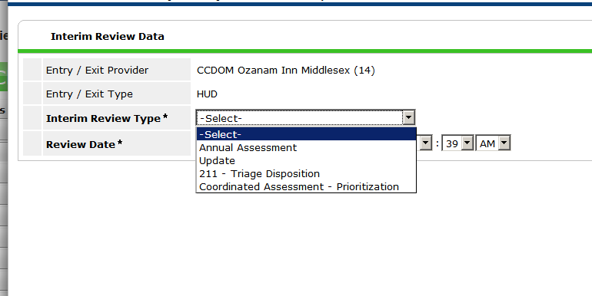
Completing Full Assessment in HMIS - Interim
Using EDA mode for your program, go to the Entry/Exit tab and click on Interim.
Click on Add Interim Review button.
From drop down box for Review
Type, choose Coordinated
Assessment – Prioritization.

Slide 35
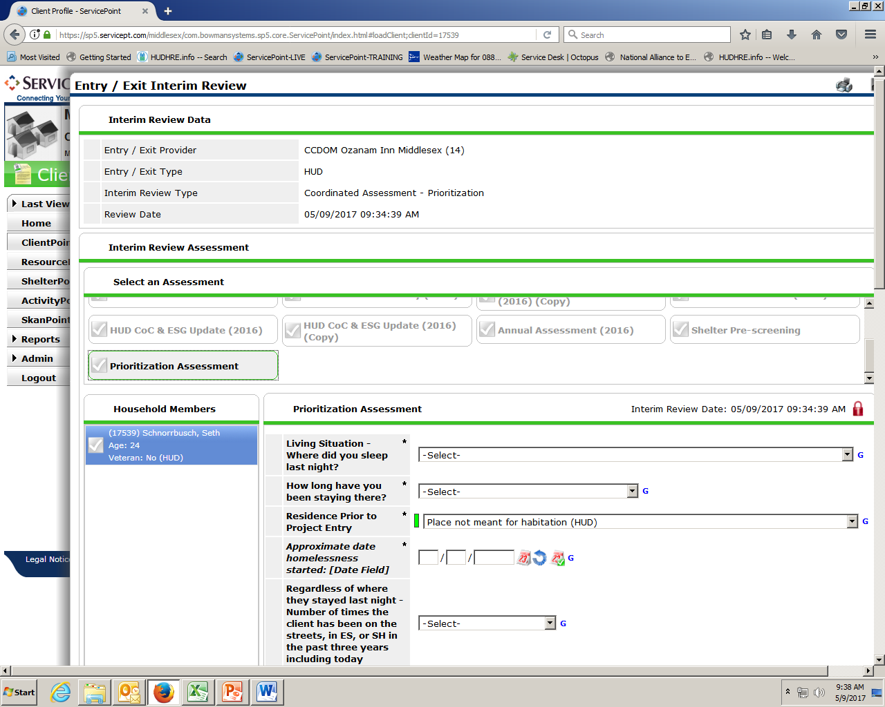
Completing Assessment (cont.)
After updating the regular HUD Verification updates, continue on to complete the actual Coordinated Assessment. Scroll back up to select the Prioritization Assessment.
Click on Prioritization Assessment in the Select an Assessment section, above the assessment questions.
Answer all of the questions. If answers are already present on the screen, please double check for accuracy, and make corrections as needed. Remember that the homeless history questions must match what you put at Entry. At the bottom, click Save & Exit.
Remember to attach the client’s homeless history to the Client Profile

Slide 36
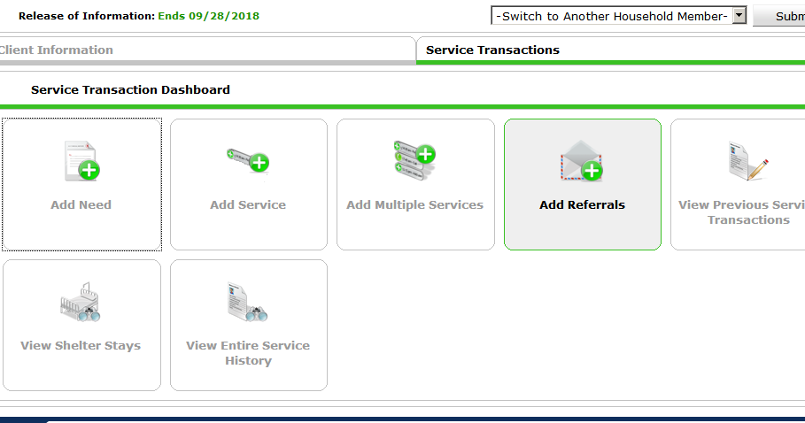
Making Referral
Switch to the Service Transaction tab. Click on Add Referral.

Slide 37
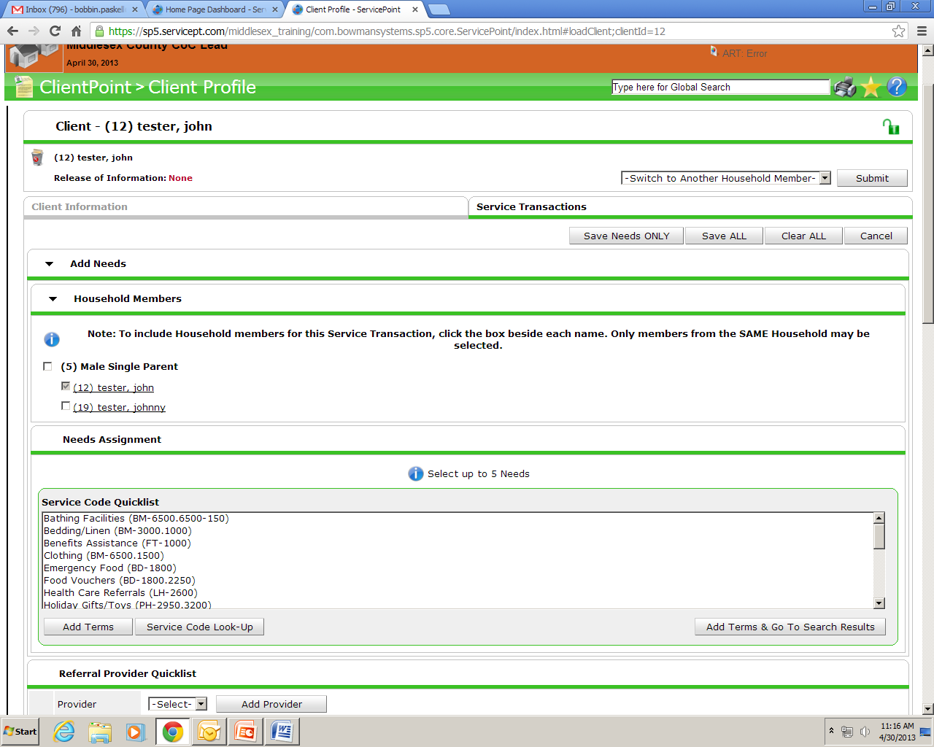
Making Referrals
Click on who the Referral applies to by selecting the names. Select ONLY the Head of Household!

Slide 38
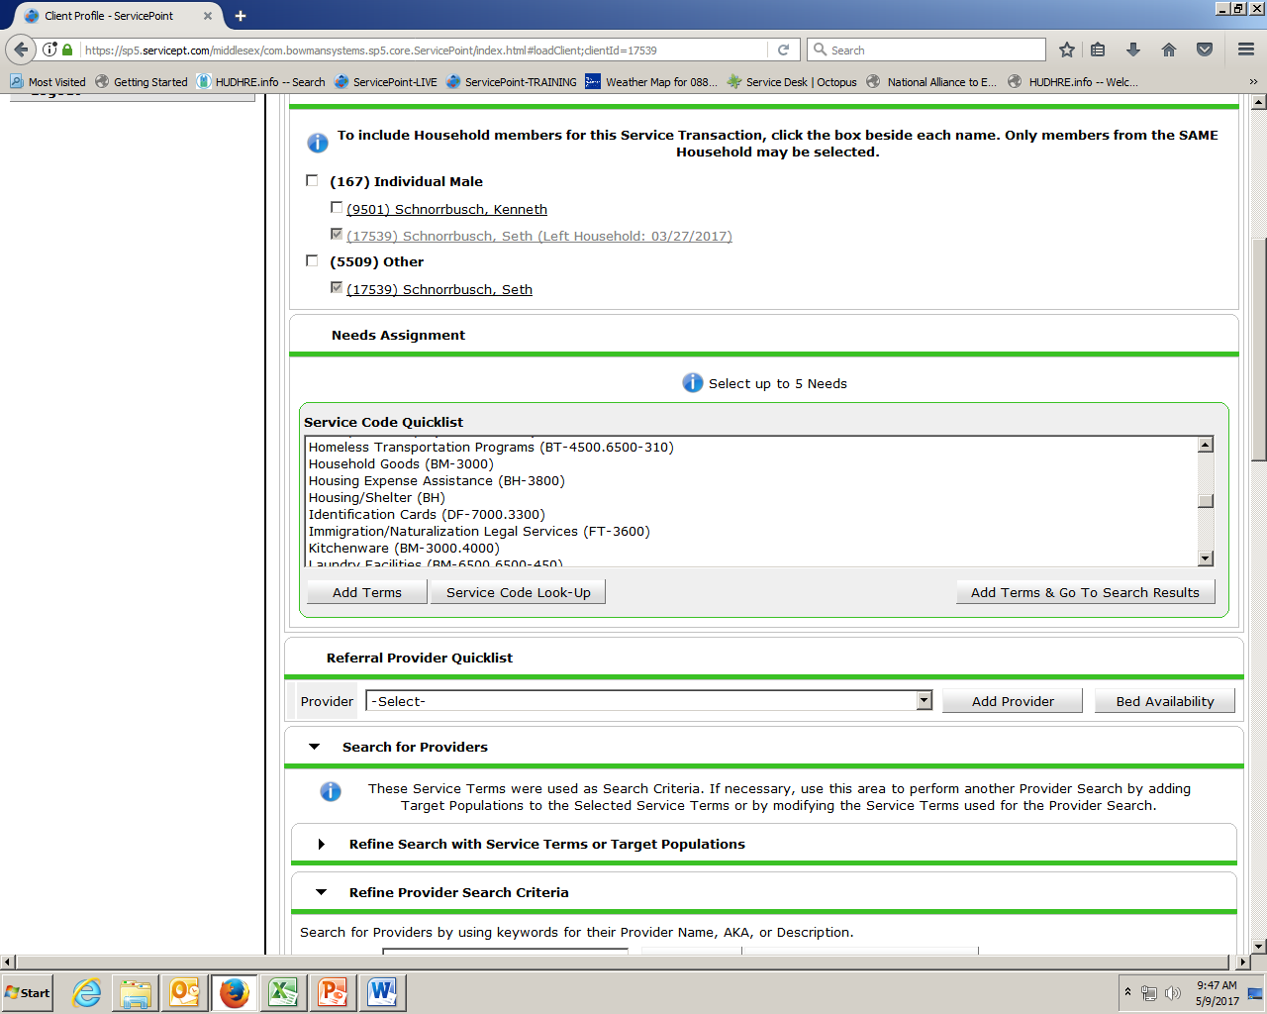
Making Referral – Service Code Selection
From the Service Code Quicklist section, scroll down and choose Housing/Shelter. Click on Housing/Shelter and then click on Add Terms.

Slide 39
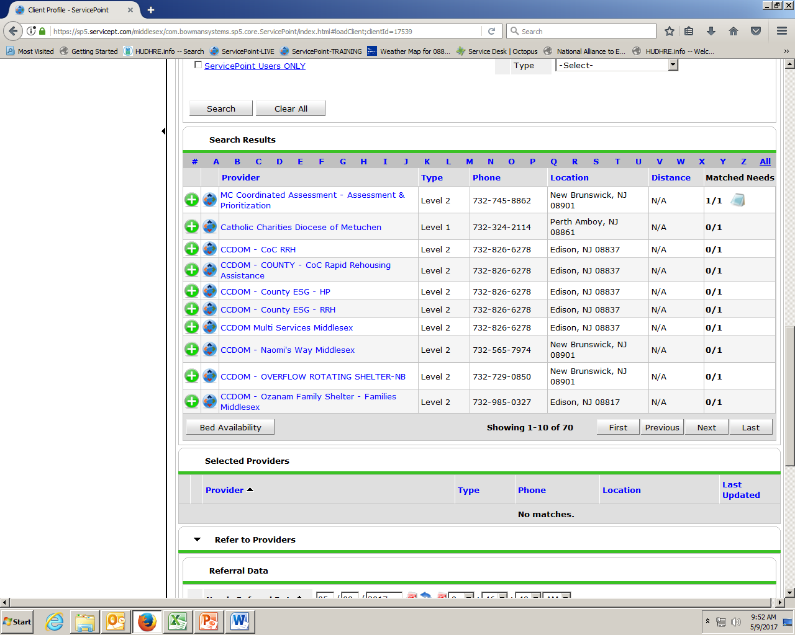
Making Referral – Select Provider
Scroll down to the Search Results.
Click on the Plus sign for MC Coordinated Assessment – Assessment & Prioritization.

Slide 40
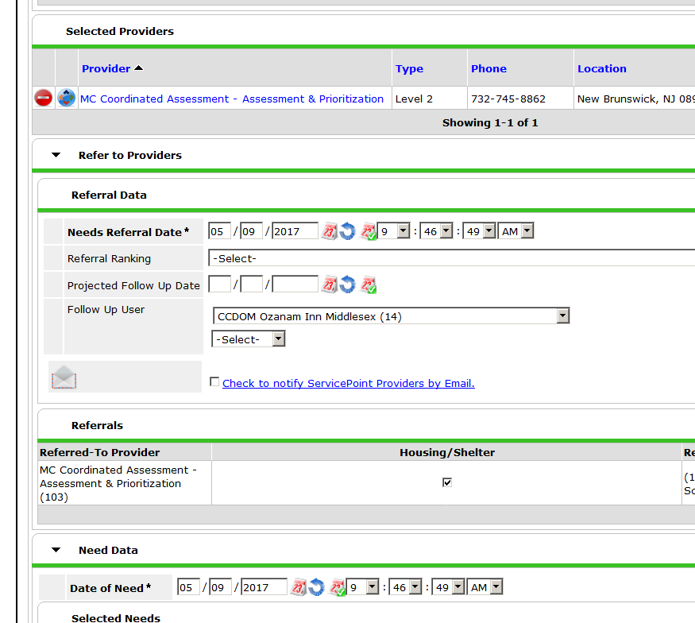
Making Referrals – Notification of CA Team
Referral provider you selected will appear in Selected Providers box.
Check the box to notify the Provider to whom you are making the referral (Coordinated Assessment).
Do not touch any of the dates or other items on this screen.
Scroll all the way down.
Click Save ALL at the bottom.

Slide 41
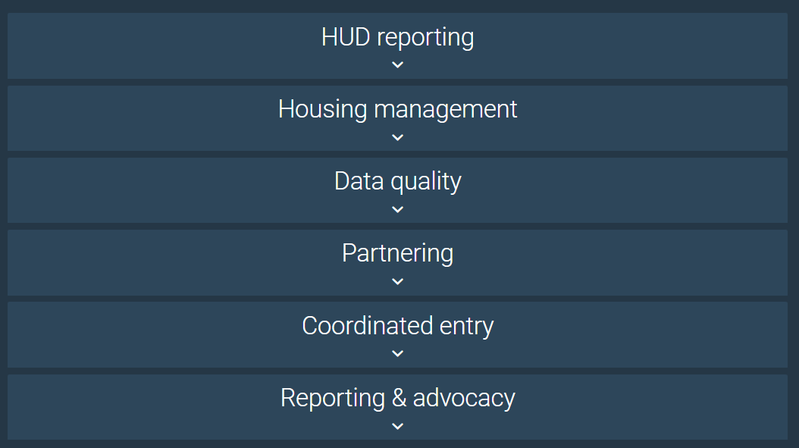
Homeless Information System (HMIS)
Middlesex County uses Wellsky’s software platform, and we use our system for all the following features.

Slide 42
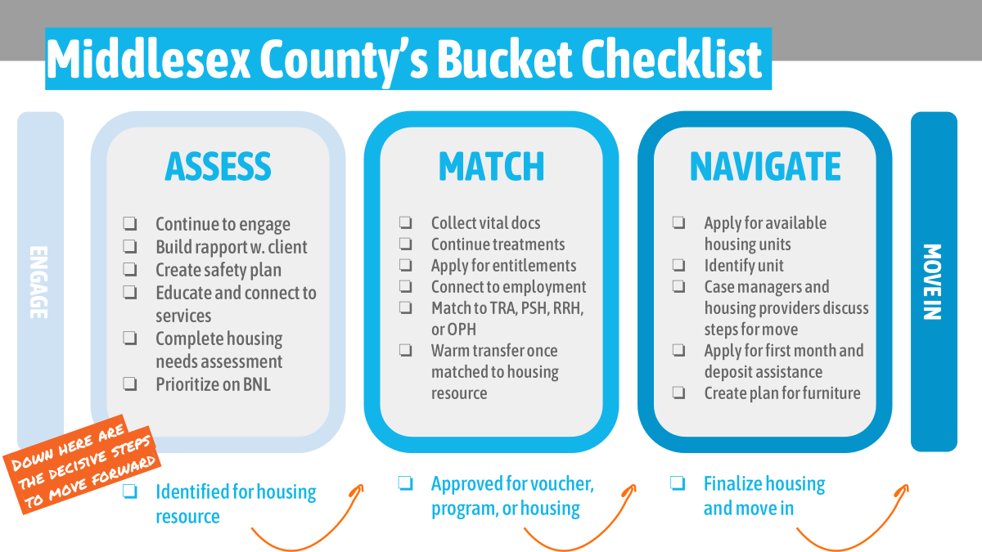
Referrals - TRA
Temporary Rental Assistance (TRA) is a short-term financial assistance program provided by the Middlesex County Board of Social Services (MCBOSS). These individuals/families need to apply for assistance through MCBOSS. They are usually already receiving GA or TANF and would NOT be eligible for RRH. This also includes those who are receiving EA placement
Types of Financial Assistance include:
Short Term Rental Assistance
Security Deposits
1st Month’s Rent

Slide 43
By-Name-List (BNL)
A comprehensive, continuously updated list of every person experiencing HUD Homelessness in a community.
Everyone who has an appropriate and acceptable CA is added to the By-Name-List. Can also be called a Prioritization List.
Look at it as a waiting list. All of these individuals/families are awaiting a referral to an available housing resource/opportunity.
This helps us to refer appropriately based on the criteria of each resource/opportunity.

Slide 44
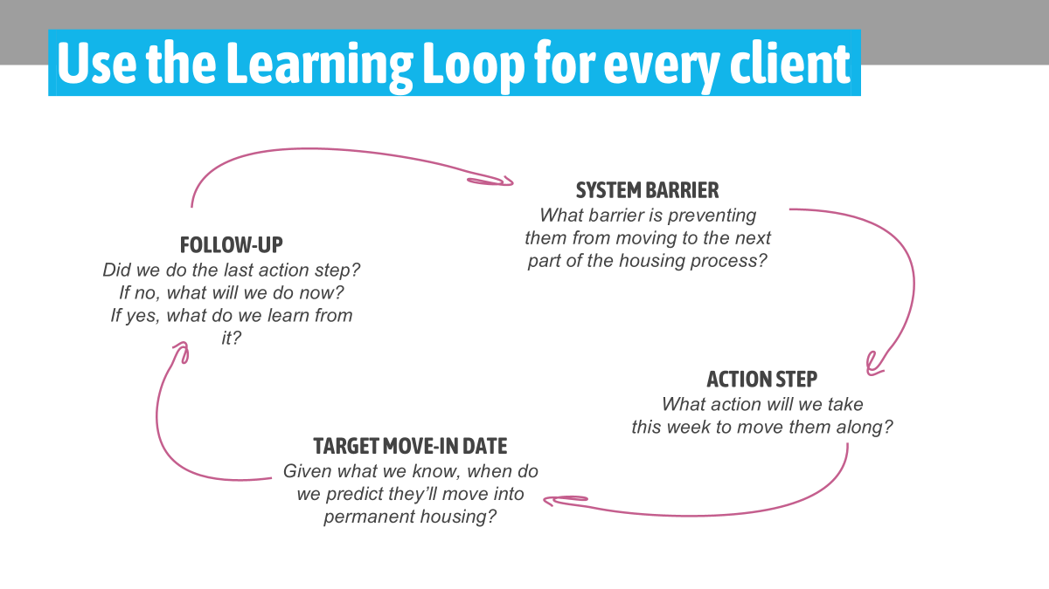
Case Conferencing
Monthly check-in calls as a community to discuss individuals/families that are on the By-Name-List (BNL).
The clients discussed MUST have a Coordinated Assessment.
We share resources that will benefit one another.
These calls are held monthly on the 4th Tuesday via Teams.

Slide 45
Resources (General)
Prevention or Diversion
Refers to External Services (Findhelp.org)
Refer to Social Service Case management (SSH)
Screen for Shelter (Add to Shelter List)

Slide 46
Feedback!☺
What do you like about the Coordinated Assessment?
What is something you would change about it?
How can we improve it?
Are there questions you would add?
What are they?
For those that attend Case Conferencing, what do you like about it?
What are some changes you would make?
How can we improve it?
Will you participate?

Slide 47

Everybody’s Getting Housed!☺

