Slide 1


HMIS Training
10/23/25

Slide 2
Agenda
Enter Data As(EDA) Mode
New Client Profile Creation
Household
ROI
Entry/Exit
Case Study (Create your own)
Case Manager
Service Transactions/Referrals
Notes
Do’s & Don’ts of HMIS

Slide 3
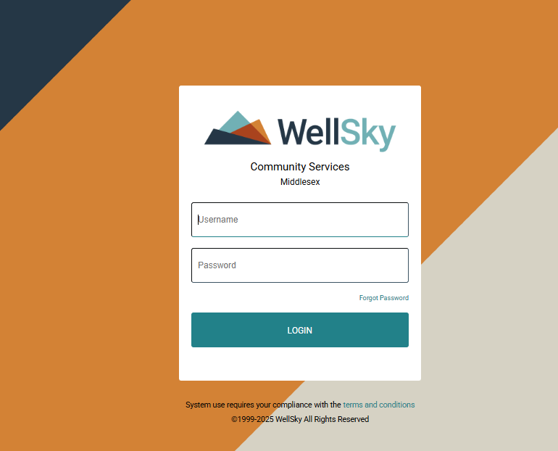
Wellsky
https://wscs.wellsky.com/middlesex/com.bowmansystems.sp5.core.ServicePoint/index.html
This is what the log in page should look like.
Your Username should be the First letter of your First name + last name
Cassandra Jones = Cjones

Slide 4
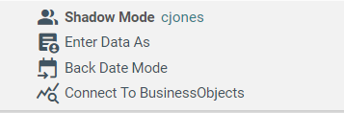
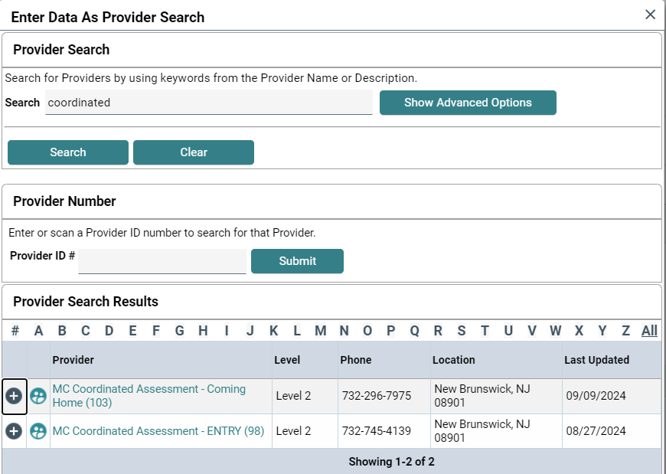
EDA Mode
In the top-right corner you can see the Enter Data As(EDA)
Always make sure while clicking the EDA Mode you select what provider you are going to enter the data as.
Your EDA will be the program you are currently enrolling that person into.

Slide 5
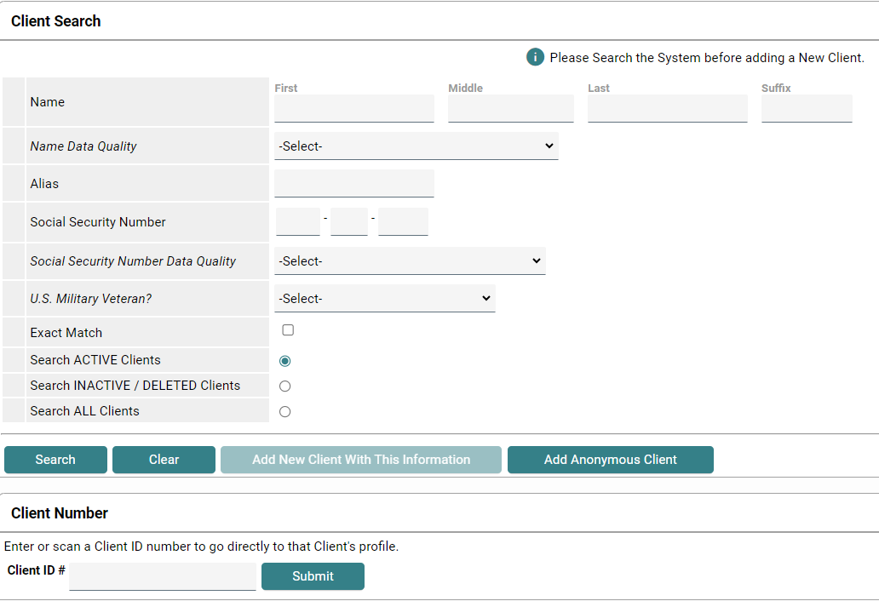
Searching a Client
Always use the first 2-3 letters of a person’s first & last name to search.
If there are multiples of that combination, try using the last 4 digits of their Social Security Number (SSN).
Searching for the person first prevents the creation of duplicate individuals/families

Slide 6
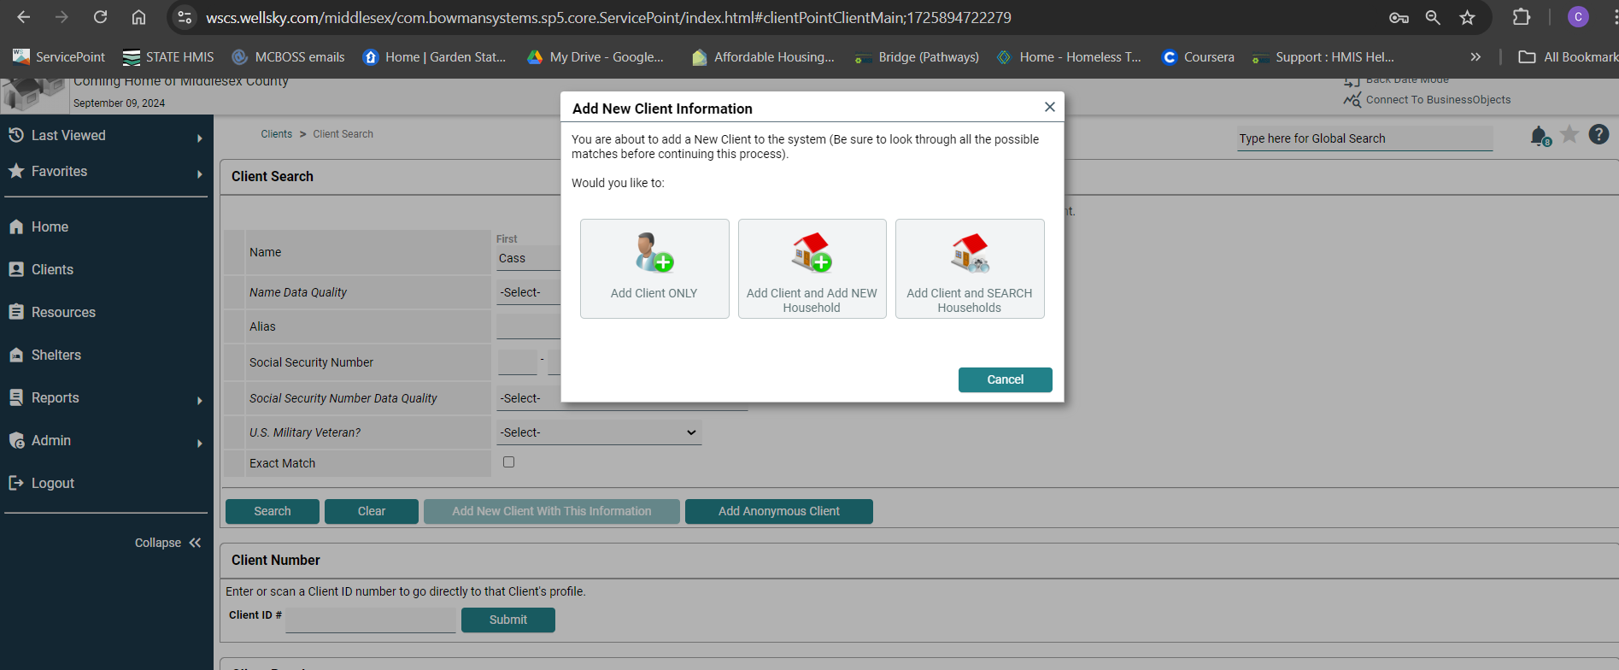
Creation of New Profile
If the person is not in HMIS:
Select “Add New Client With This Information”.
Always Select “Add Client and Add New Household”
Regardless if the client is Single or Not

Slide 7
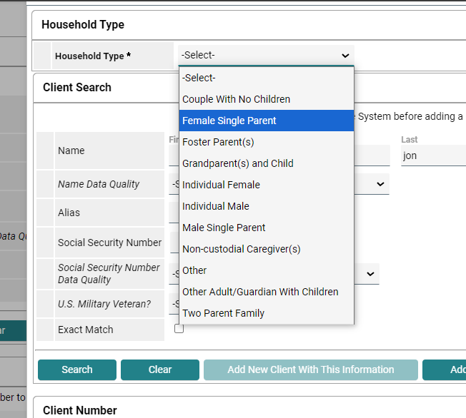
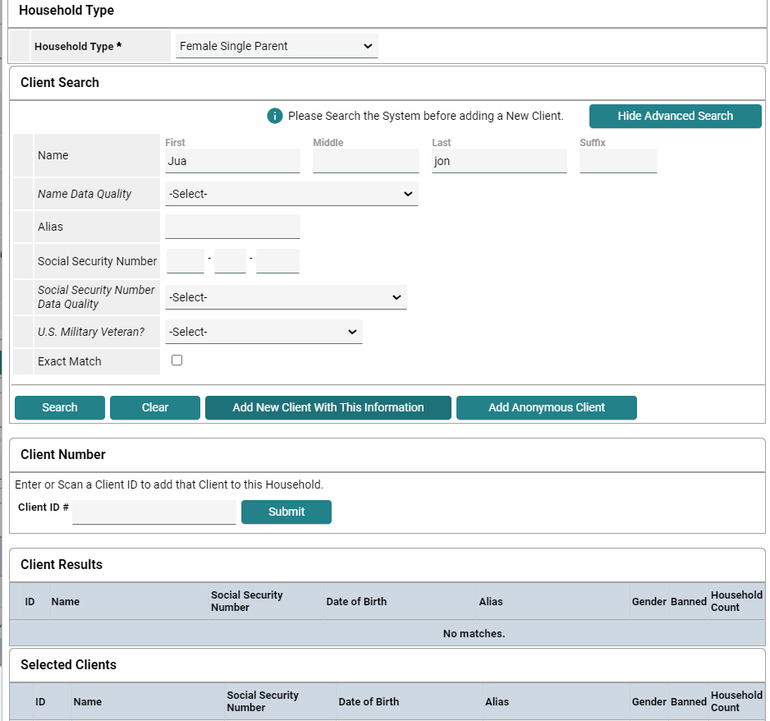
Select the Household Type. This should match best with the Household dynamic. DO NOT use “Other” unless it actually applies.
Search for the next Household Member using the first 2-3 letters of their first and last name.
If that person is not already in HMIS, click “Add New Client With This Information”.

Slide 8
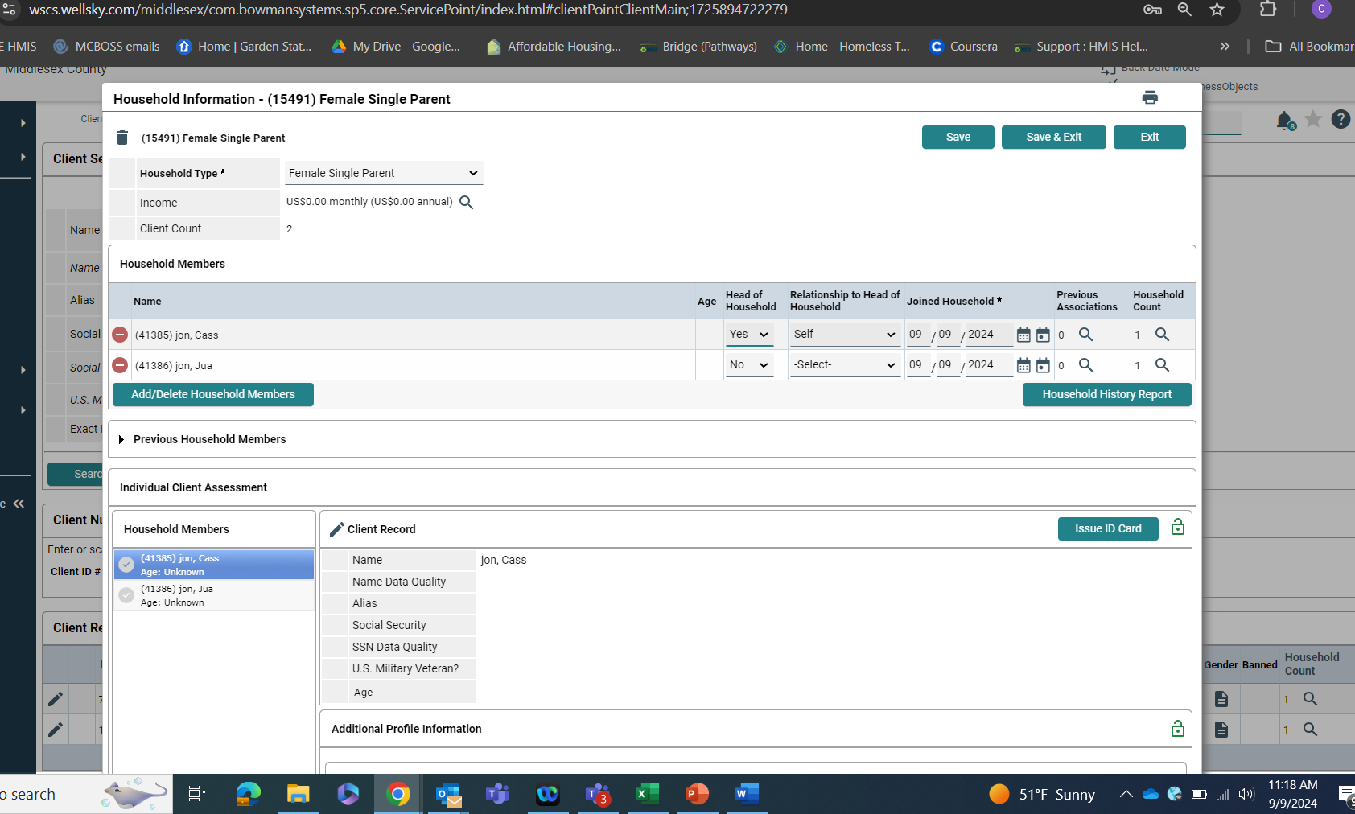
Make sure the Head Of Household is identified.
Relationship to Head of Household MUST identified for each member of the household.

Slide 9
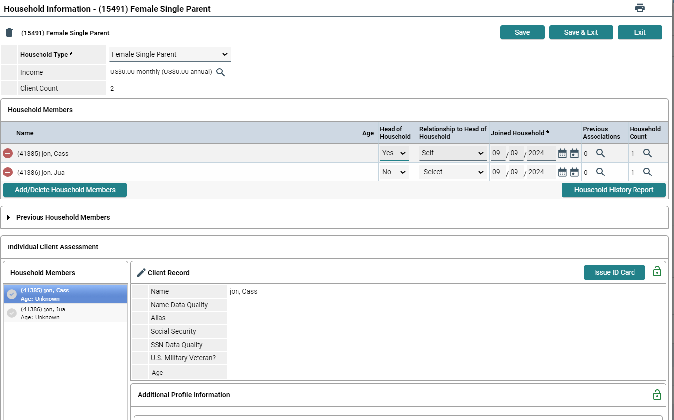

Household Tab
Complete the Client Record & all required information for each household member. (It’s all required.)
These questions cannot be skipped.

Slide 10
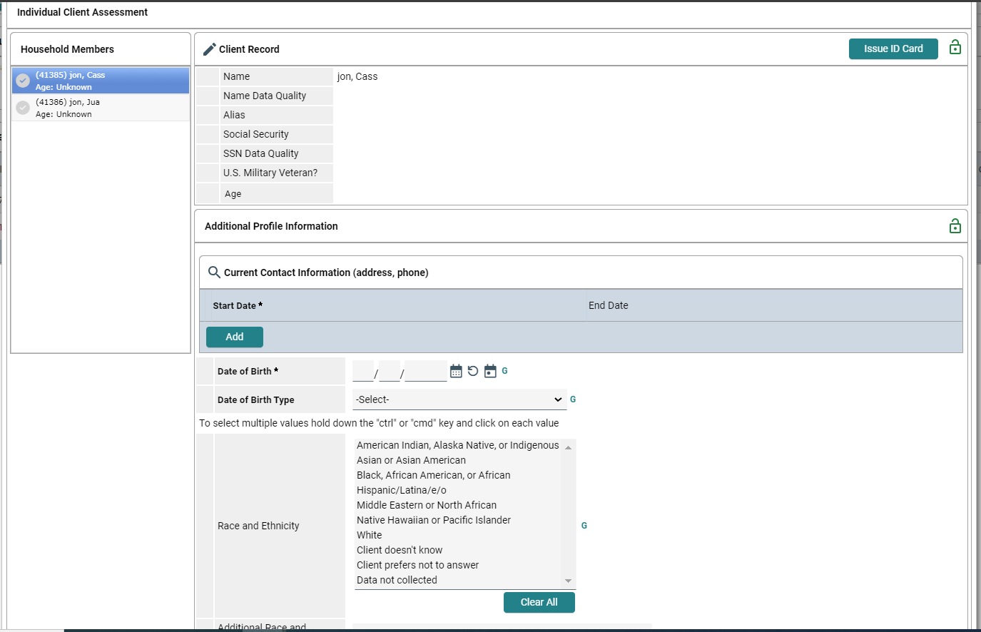
All Required Information
Click “Save & Exit” before exiting this screen.

Slide 11
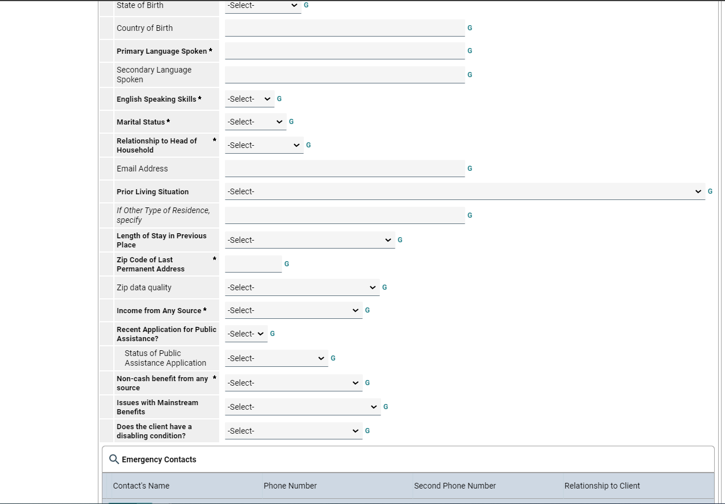




All Required Information Continued
These questions are commonly skipped. They need to be answered.
Click “Save & Exit” before exiting this screen.

Slide 12
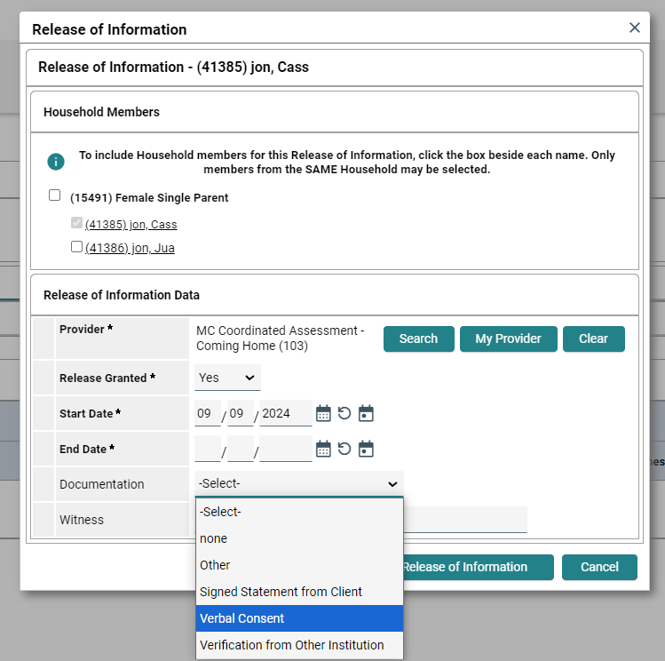
ROI - Release of Information
Inform the individual you are adding them to our database. This is how agencies providing services will share information.
Choose “Verbal Consent”
Save Release of Information.

Slide 13
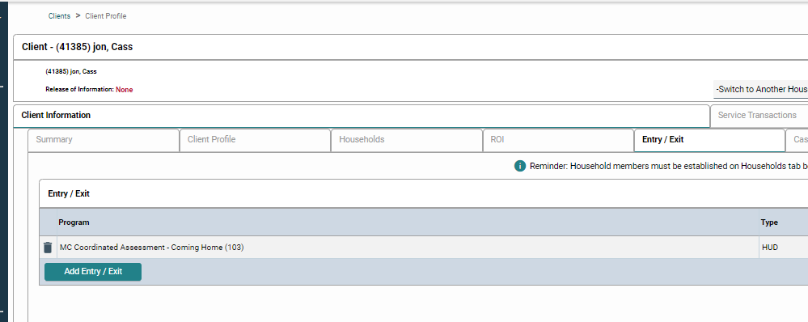
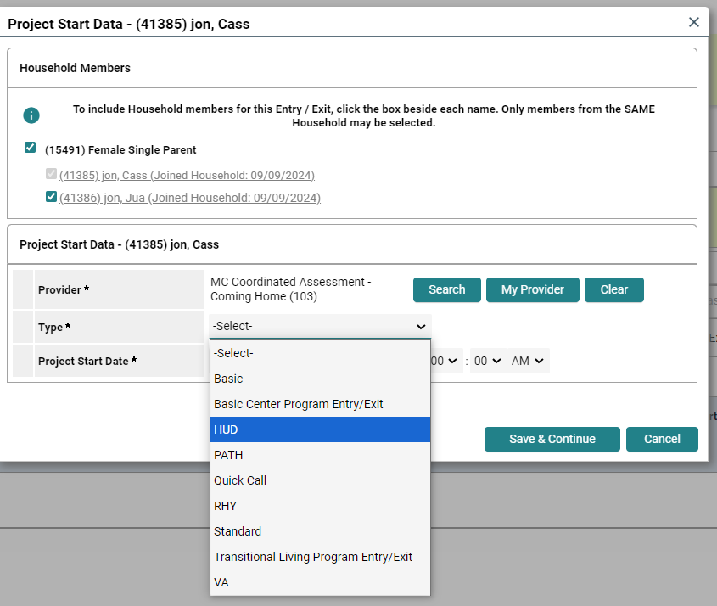
Entry or Project Start Date
When an individual/family enters your program, we use the “Entry/Exit” Tab“ to add a new Entry.
We use this same tab to Exit them from the program.
Make sure the ENTIRE household is checked off to be included in this program.
Provider - your program (same as your current EDA Mode)
Type - HUD
Project Start Date - when they entered the program (usually today at midnight).
Save & Continue

Slide 14
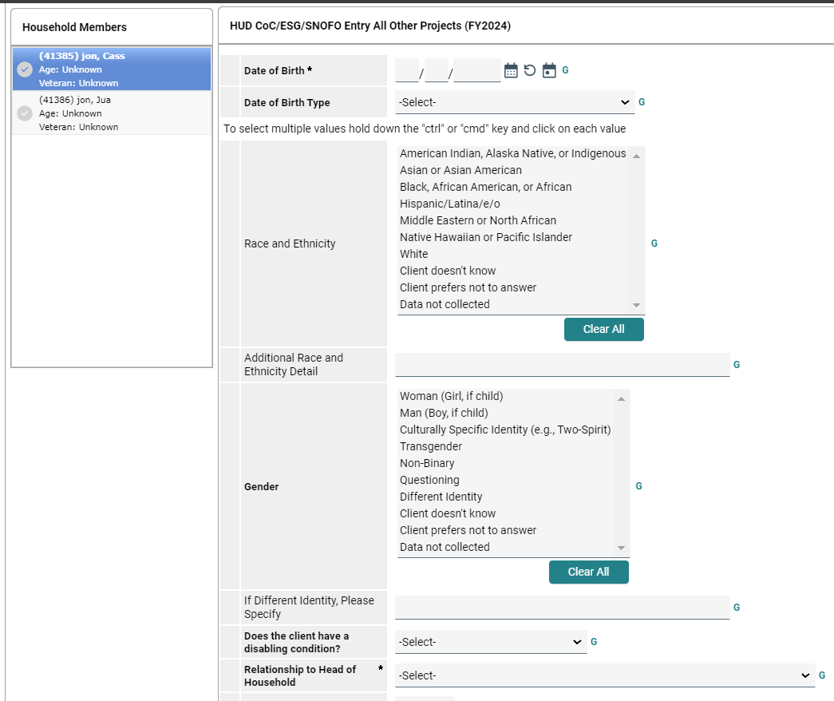
Entry continued…
Some of this information should auto-populate if the Household Tab was completed.
Relationship to Head of Household MUST be completed.

Slide 15
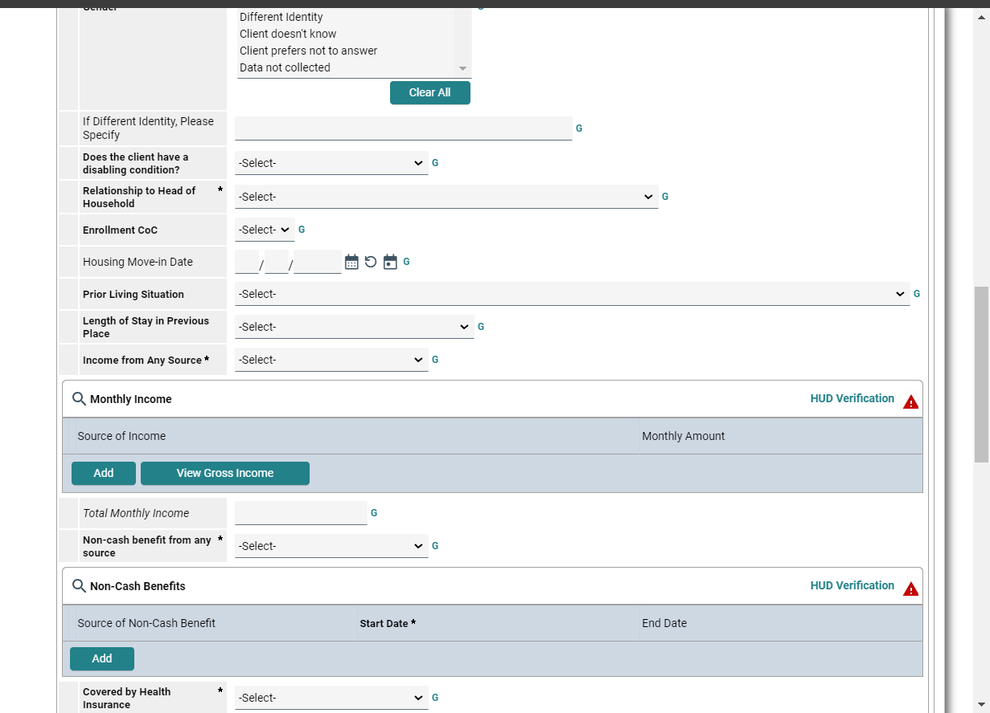
Entry continued…
Disabling condition - MUST be answered “yes” or “no”.
Enrollment CoC should be “NJ-507”
Prior Living Situation - where were you last night?
Income - yes or no
If there is a Red triangle for HUD Verification = MANDATORY

Slide 16
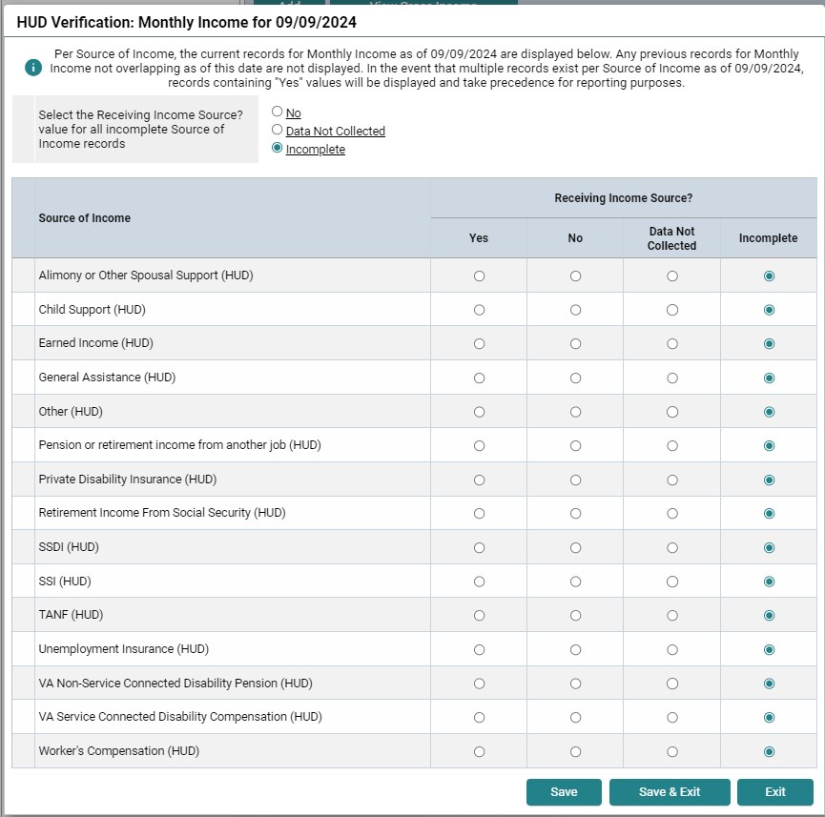
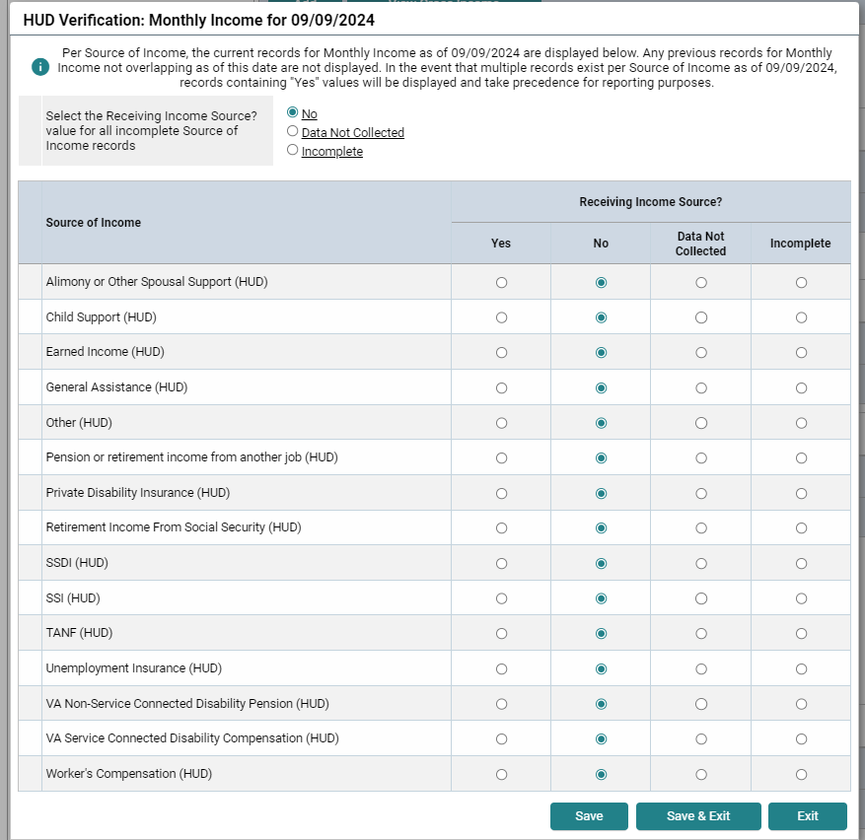
HUD Verification
Check the “No” at the top and all the answers become “No”.
Only mark “Yes” if it’s true.

Slide 17
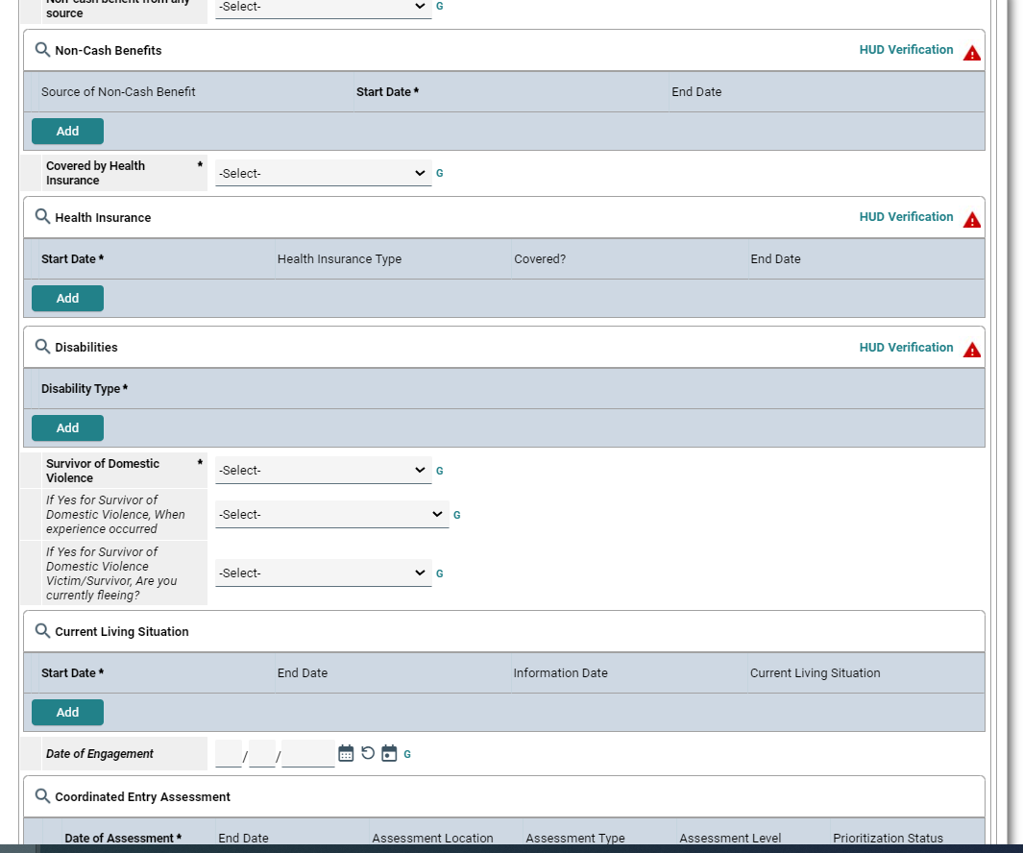
Still in the Entry…
Health Insurance - MUST be answered “yes” or “no”.
Complete the HUD Verification for the Type of Insurance.
“If yes to Medicaid, what is your HMO?” When this question appears, it MUST be answered.
If you answered “yes” to the Disabling Condition question, it MUST be listed with the Disabilities.

Slide 18
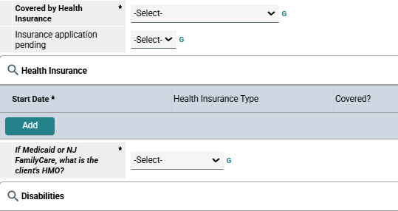
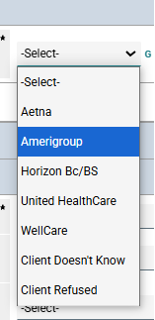
Still in the Entry…
Health Insurance - MUST be answered “yes” or “no”.
Complete the HUD Verification for the Type of Insurance.
“If yes to Medicaid, what is your HMO/MCO?” When this question appears, it MUST be answered.
If you answered “yes” to the Disabling Condition question, it MUST be listed with the Disabilities.

Slide 19
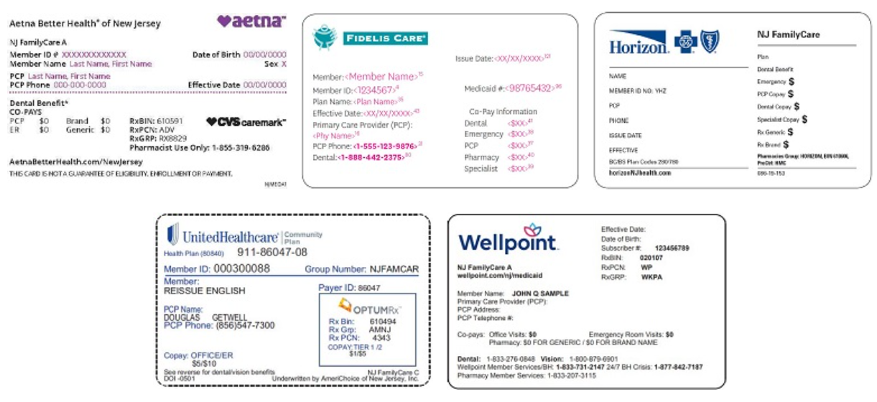
Managed Care Organizations (MCOs) in NJ
Aetna
WellPoint (previously Amerigroup)
Horizon BC/BS
United HealthCare
Fidelis (previously Wellcare)

Slide 20
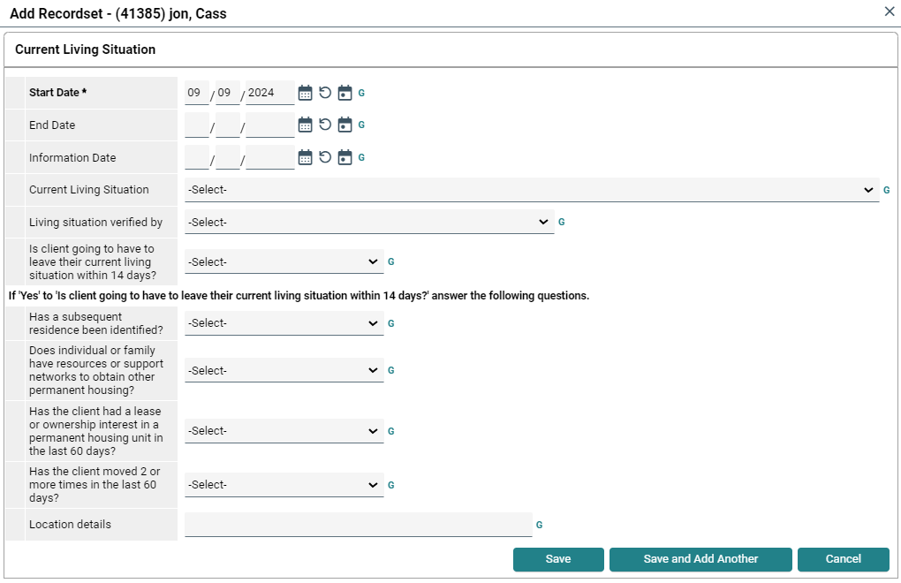
Current Living Situation = Where are staying right now?
Start Date will automatically be today’s date.
Information Date - also today’s date.
Current Living Situation = Where are you staying right now?
Verified by - Your EDA Mode
After completion, Save it.

Slide 21
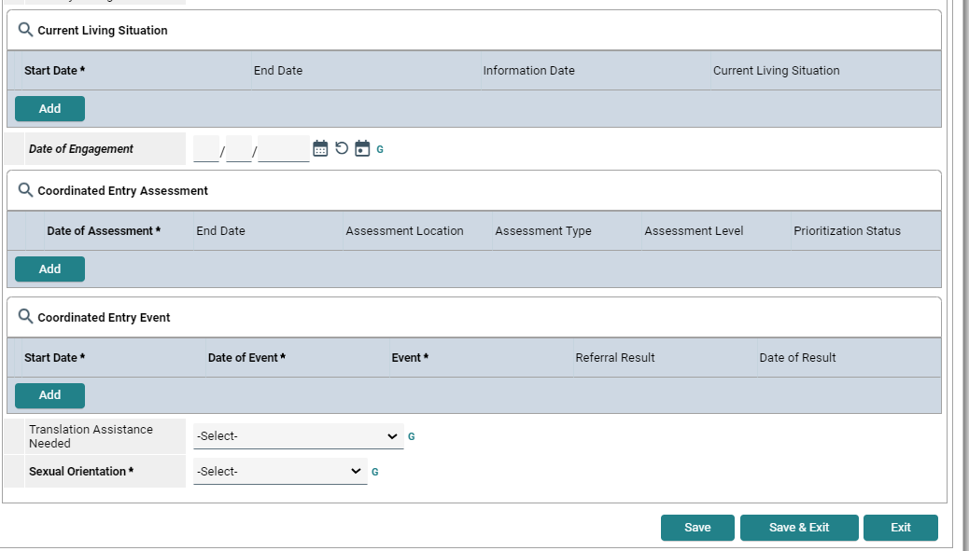
Other Coordinated Entry Fields
Coordinated Entry Assessment - to be completed by The Coordinated Assessment Team when a Coordinated Assessment is received for that Household.
Coordinated Entry Event - to be completed by The Coordinated Assessment Team when a referral is made based on that Assessment (unless otherwise told to do so by your supervisor/director).
Always “Save & Exit”.
Please answer the Sexual Orientation question if it appears.

Slide 22
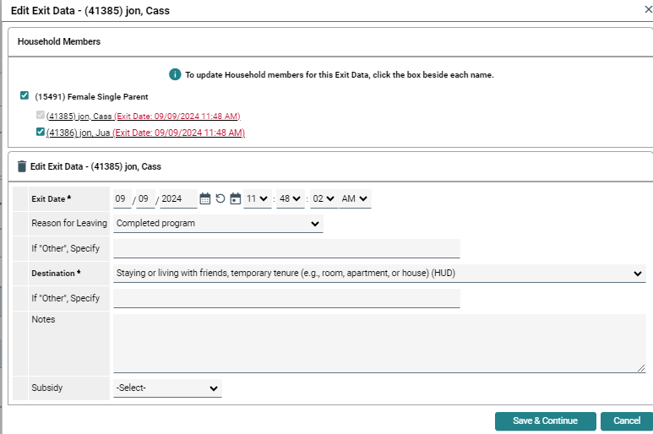
Exits
Exit the entire Household from the program when they have completed it.
This may vary based on your program.
Reason for Leaving - should be “Completed program” unless there are other circumstances.
Destination - Avoid using “No exit interview”
Save & Continue

Slide 23
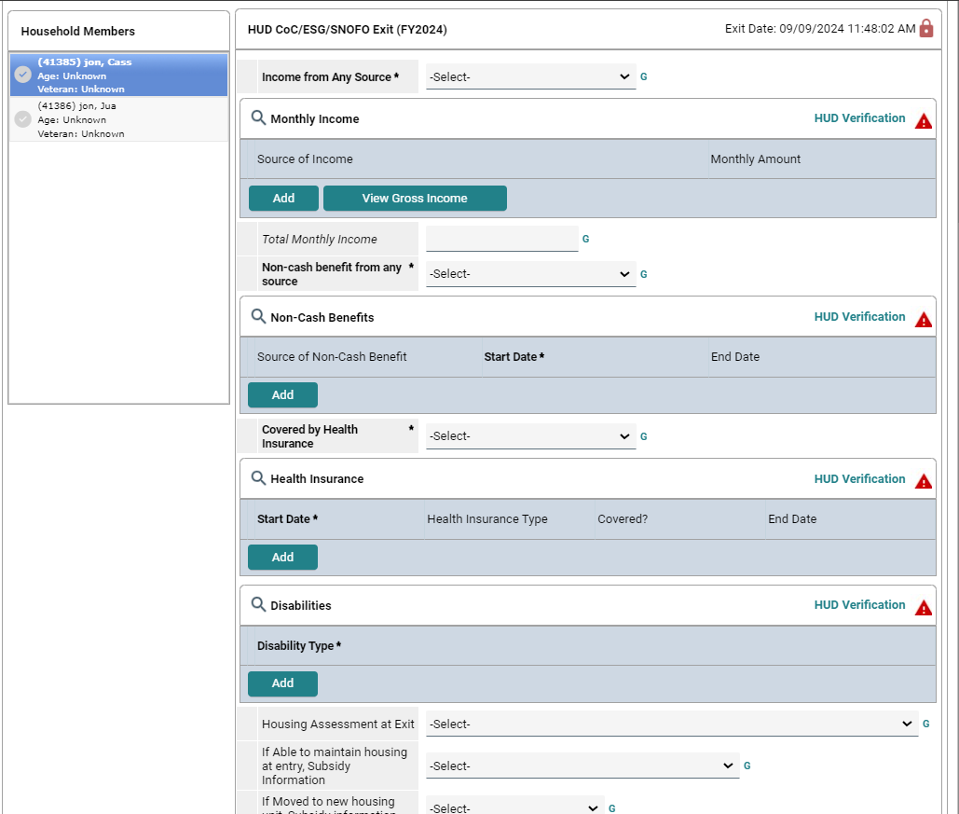
Exits continued…
Same questions from the Entry.
Complete this in its entirety for each household member.
Save & Exit

Slide 24
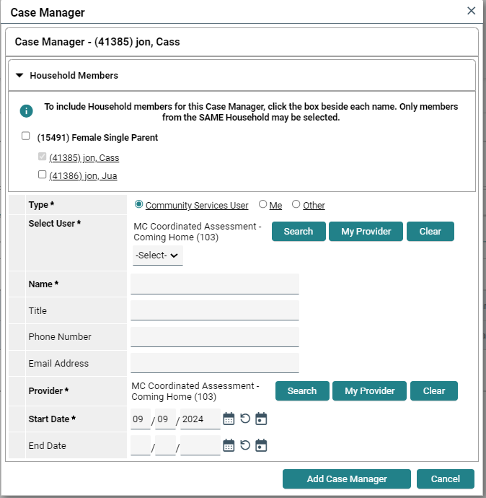
Case Manager Tab
Check the Head of Household ONLY
Type - choose “Me” as the Case Manager to assign yourself & your information should populate.
“Add Case Manager” will save it.

Slide 25
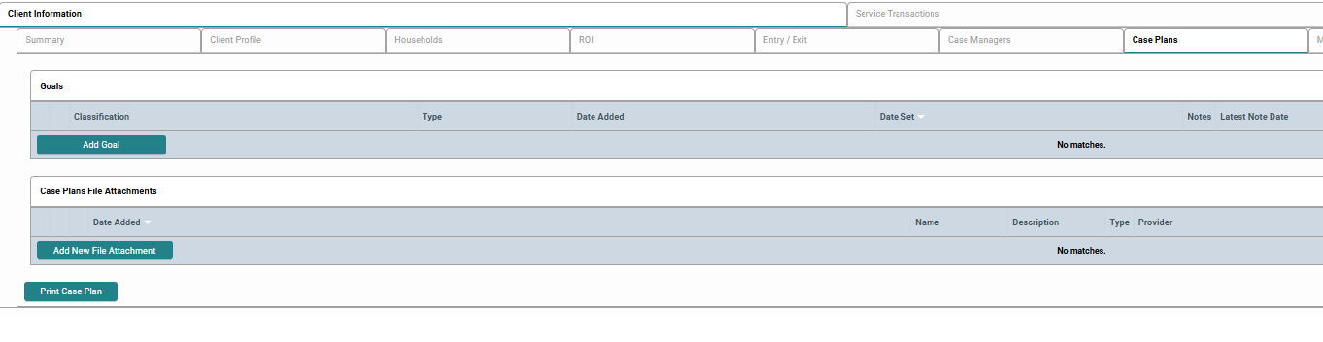
Case Plans Tab
ADD GOAL

Slide 26
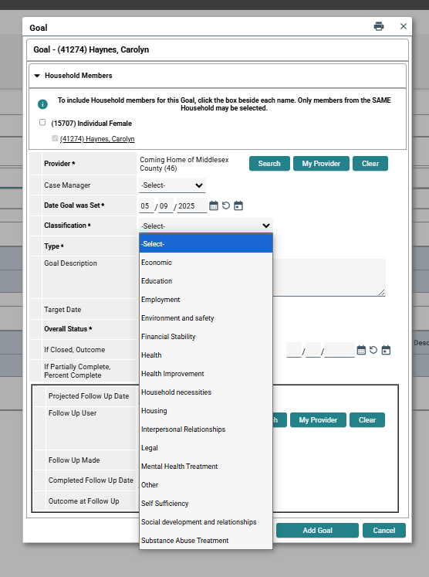
Case Plans Continued
This box will open up after you click “Add Goal”.
Make sure you are in the correct EDA Mode. The “Provider” will be automatically selected.
Select yourself as the Case Manager.
Choose a “Classification” from the drop-down.

Slide 27
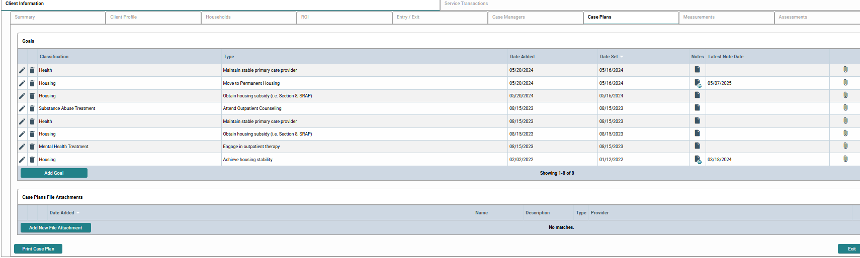
Case Plans Continued
You can add as many Goals as you’d like.
Feel free to upload necessary documents
Add case notes for appropriate follow-up.

Slide 28
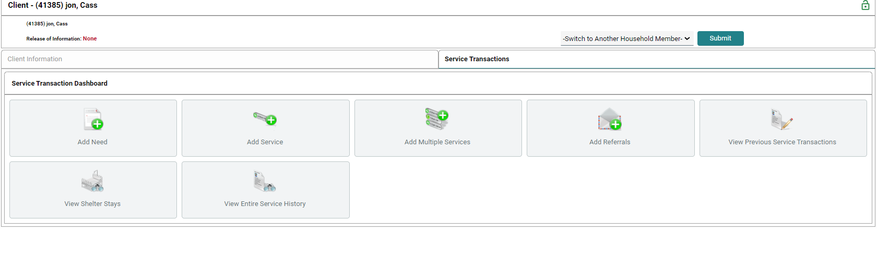
Service Transactions Tab
Add Need
This Tab is used for the Head of Household.
All Needs, Referrals and Service Transactions should be under the Head of Household ONLY !!!

Slide 29
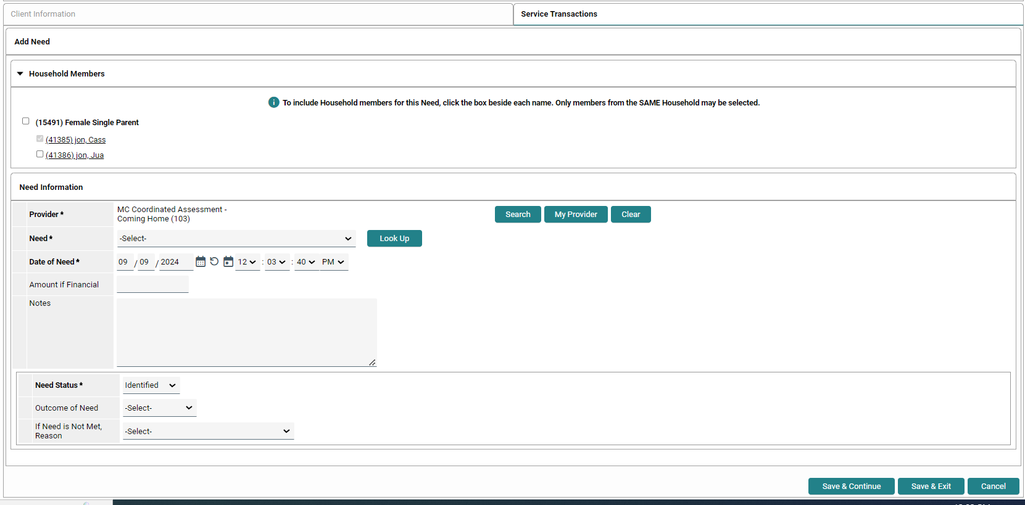
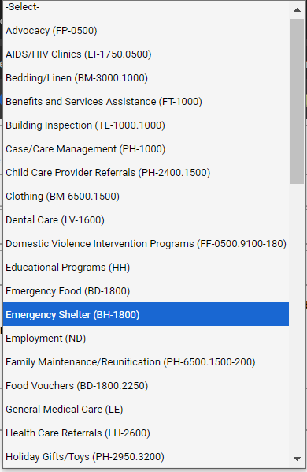
Service Transactions continued…
Check the Head of Household ONLY!!!
Need - Choose the appropriate need for the referral.
The “Need Status” is “Identified”. Do not change that unless you, yourself, are the provider for that service.
Save & Continue

Slide 30
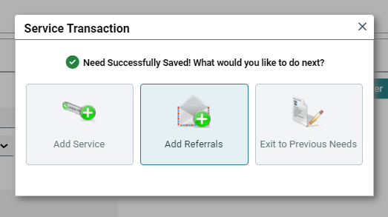
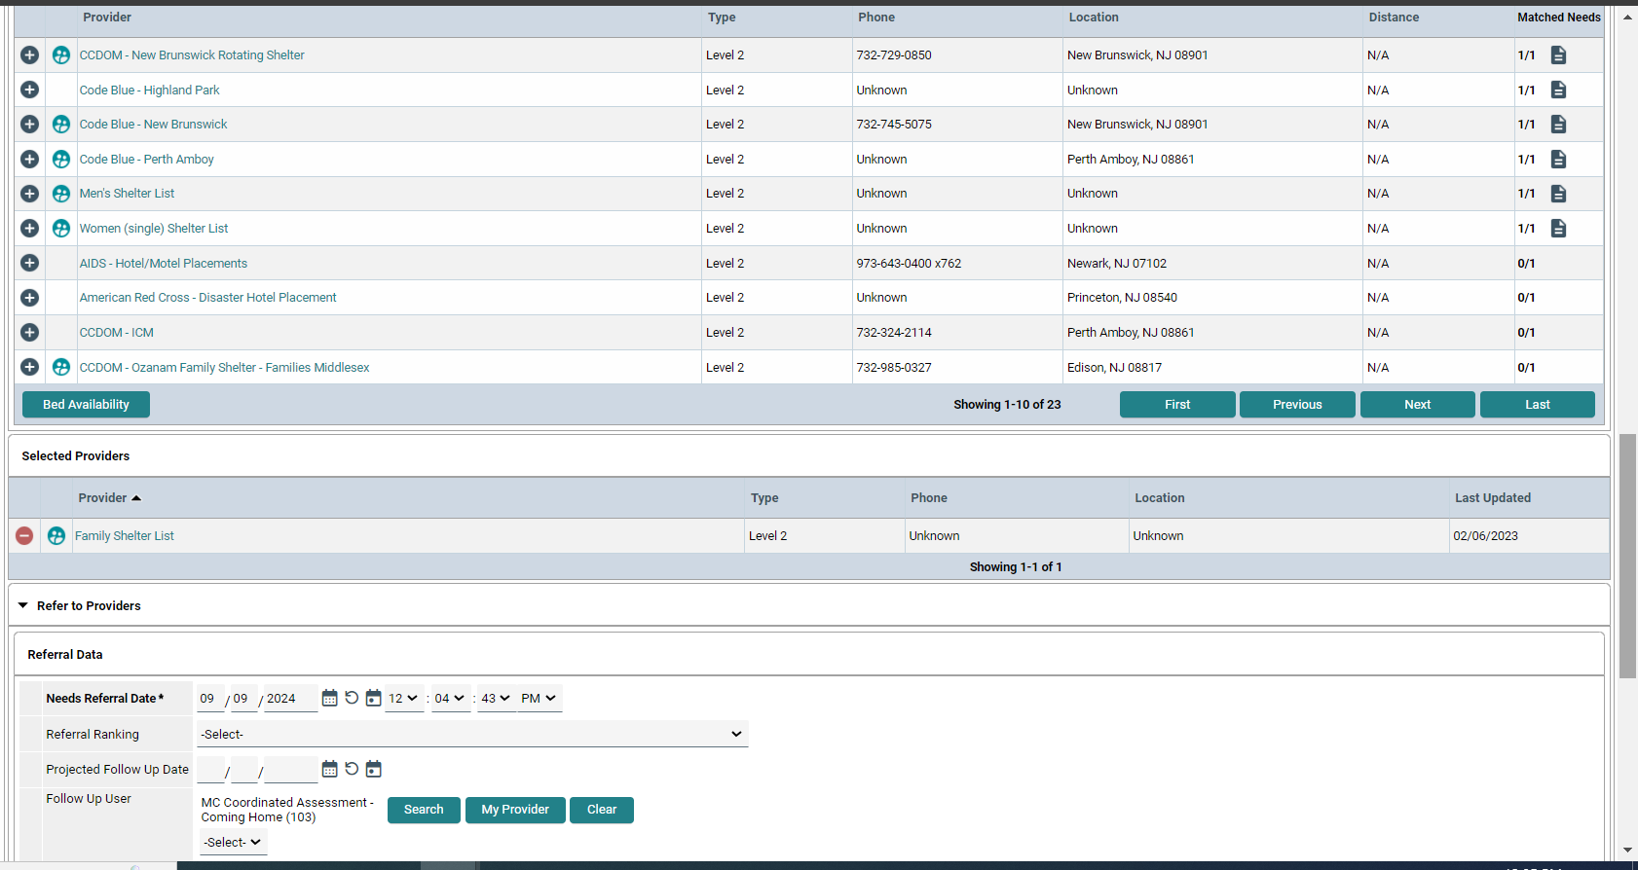
Service Transactions continued …
Add Referral
In this example, the family is being referred to the Family Shelter List as that is the only acceptable option. (Shelter referrals are ONLY done by Access Navigators.)

Slide 31
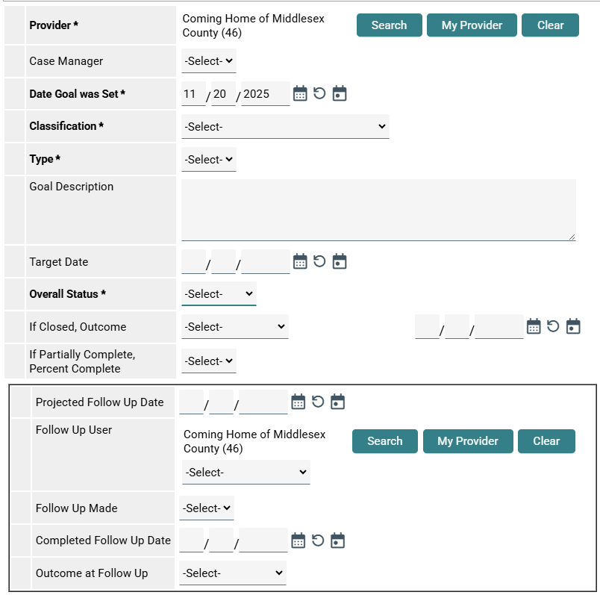
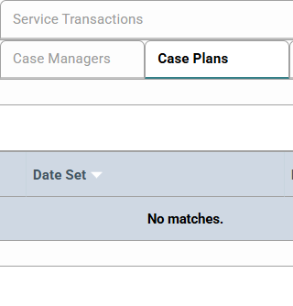
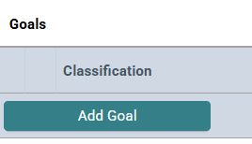
Follow-Up Setup
Provider is same as your EDA Mode
Select the Classification and the type
Click on Overall Status and check whether the goal is 'Identified', 'Closed' or 'In Progress'
Enter the projected follow up date you estimate based on the type
Make sure the follow up User is selected
Click Save and Exit
Click on Case Plans
Click on Add Goal

Slide 32
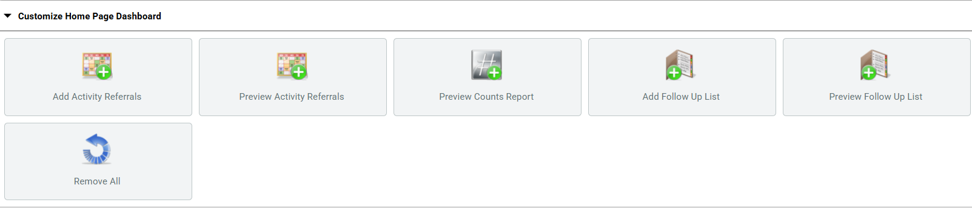
Dashboard Setup
Go to your login page
Click on Add Follow Up List
You will see the list of clients who you have to follow up

Slide 33
Do’s and Don’ts of HMIS
Do -Always “Save & Continue” or “Save & Exit” where appropriate.
Do - Always add a Note to the Profile page and/or Case Manager Tab after client interaction.
Do - collect an email address and/or back up phone number.
Do - ask if you’re not sure.
Do - Use the resources that have been provided.
Do - Close the Entry if that individual/family is not currently HUD Homeless or enrolled to your program.
Don’t use “Data Not Collected”.
Don’t use “Client Refused”.
Don’t use “Client Doesn’t Know”.
Don’t use “Client prefers not to answer”.
Don’t skip the Veteran question.
Don’t “Lock” the information.
Don’t leave MANDATORY fields blank.
These are the things that cause major Data Quality Errors.

Slide 34
Reference
Use this site for FREE trainings
https://pathwaysmisi.talentlms.com/plus/login

