Slide 1


Navigating the System
Middlesex county

Slide 2


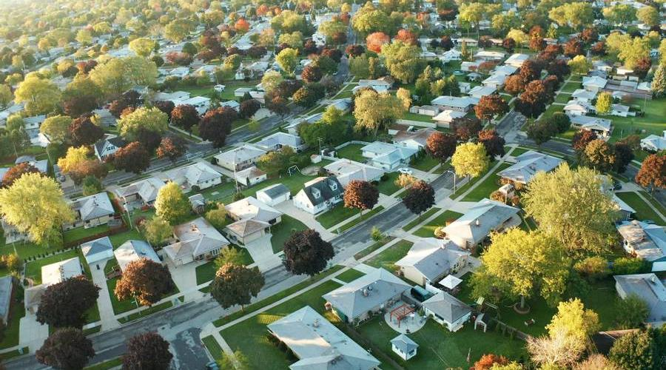
Agenda
WellSky, Middlesex County HMIS
Coordinated Entry System Overview
211 Collaboration & Access Sites
Types of Homelessness
Making Shifts Happen: Coordinated Prevention
Coordinated Assessment Overview
MCBOSS
Referrals
Shelter
Community-Based Case Management
PIT (Point-In-Time Homeless Count)
CoC Partnerships

Slide 3
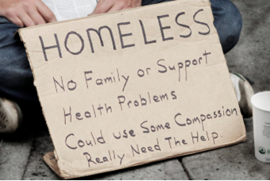
Housing is absolutely essential to human flourishing. Without stable shelter, it all falls apart.
Matthew desmond

Slide 4
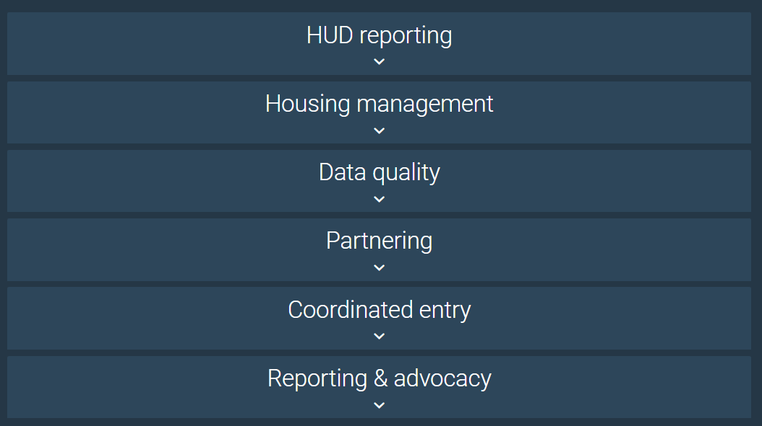
Homeless Information System (HMIS)
Middlesex County uses Wellsky’s software platform, and we use our system for all the following features.

Slide 5
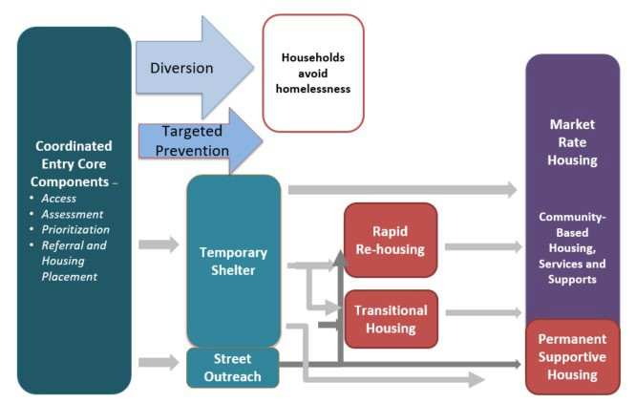
Coordinated Entry System Overview
Coordinated Entry is a centralized process for individuals and families facing a housing crisis. Coming Home streamlines intake and service referrals to ensure cohesion within the Continuum of Care (CoC).
Key features of the system include:
A thorough and standardized assessment for holistic participant evaluation.
Prioritizes individuals and families for available housing and support resources.
Emphasizes partner collaboration to enhance process effectiveness.

Slide 6
What is 211?
NJ211 is a statewide free and confidential information and referral service that connects people with important community resources and assistance. It serves as a comprehensive helpline for individuals seeking health and human services information. Assistance is offered 24/7 hours a day 365 days in 150 languages.
Services Provided:
Emergency shelter and housing assistance
Food assistance programs
Mental health and substance abuse support
Healthcare Resources
Employment and education services
Utility assistance
Support for seniors and people with disabilities
Disaster response and recovery information
Accessing 211:
Dial 2-1-1 or call 1-877-652-1148
Text the zip code to 898-211
Live chat and Search the Database at www.nj211.org
Email at info@nj211.org,

Slide 7
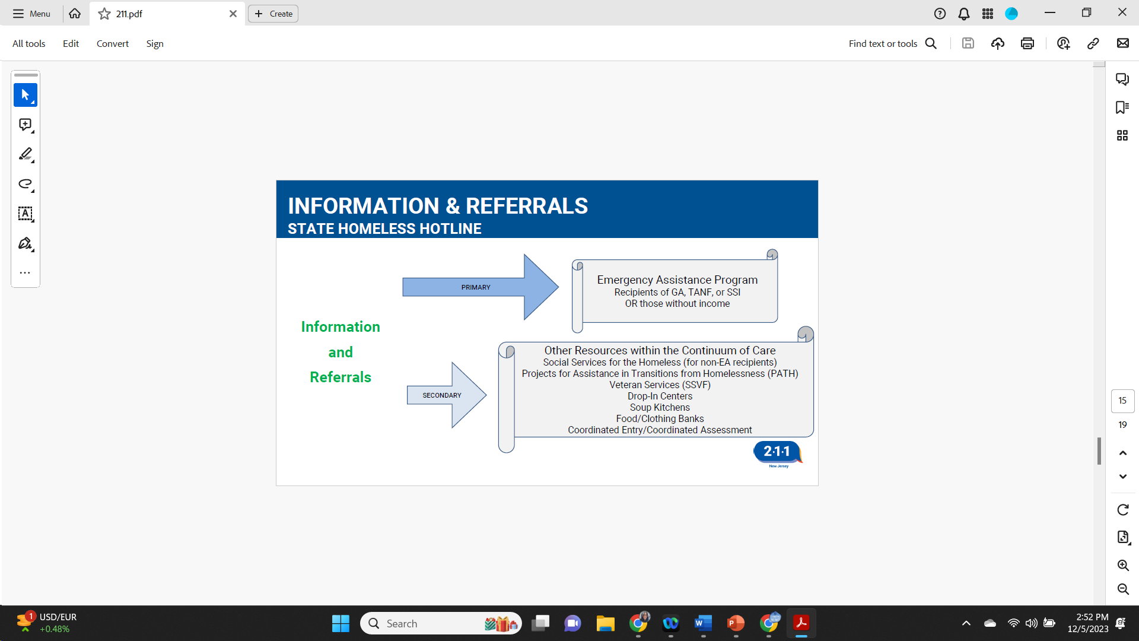
211 is also NJ’s Homeless Hotline
211 Operator will provide a referral to Coming Home via the state HMIS system AWARDS.
Coming Home CEA Team will pull appropriate calls from AWARDS and return the call within 24 -48 hrs.

Slide 8
Coming Home of Middlesex County
Coming Home manages Middlesex County's Homeless Management Information System (HMIS), providing real-time data for effective intervention. We oversee the County Coordinated Entry/Assessment System, ensuring uniform assessments and prioritizing resource allocation. This work streamlines assistance for those in housing crises often referred through 211, and our physical access sites for connections to essential support.
Our Physical Access Sites:
Unity Square Community Center 81 Remsen Avenue New Brunswick, Monday - Thursday| 9:00 AM - 4:00 PM
Reformed Church of Highland Park 19 S 2nd Avenue Highland Park, Tuesdays | 2:00 PM - 4:00 PM
First Presbyterian Church of Metuchen 270 Woodbridge Avenue Metuchen, Thursdays | 9:00 AM - 11:30 AM
Center for Support, Success & Prosperity 392 Smith Street Perth Amboy, Monday - Friday | 9:00 AM - 5:00 PM
Middlesex College Community Resource Hub & Food Pantry Room CC 170 A, 2600 Woodbridge Avenue Edison, Thursdays | 12:00 PM - 5:00 PM

Slide 9
Key Objectives of CEA
Increased Efficiency:
Streamline the response to housing-related crisis for quicker and more effective outcomes.
Improved Fairness:
Ensure fairness in addressing the needs of clients in crisis situations.
Enhanced Access:
Increase the ease of access to services and resources for clients facing housing-related challenges.
Flexibility:
Design the system to be adaptable to various crisis scenarios.
Regular Revisitation:
Establish a framework for the periodic review and optimization of the coordinated entry system.
.
Driving Change Using Data:
Use data collection to strengthen our response to homelessness. Identify gaps and needs and strategically advocate for programs and enhanced community support.

Slide 10
Types of Homelessness
Place not meant for habitation
A vehicle, an abandoned building, train stations, anywhere outside.
Precariously housed
Couch surfing, doubled up, staying with friends or family
Emergency Shelter
A shelter for homeless persons, motel paid for by an agency (MCBOSS, DCP&P, a church, non-profit agency, etc.…)
Self-paid motel
Staying in a motel that they are paying for or someone they know is helping to pay.

Slide 11
HUD Definition for Homeless
Literally Homeless | Lack of a fixed, regular, and adequate nighttime residence. Includes living in places not meant for habitation, shelters, or temporary residence in emergency shelters or institutions for under 90 days. Immediate pre-institutional residence in emergency shelters or places not meant for habitation is also encompassed in this definition.
Imminent Risk of Homelessness | Individuals or families facing imminent loss of their primary nighttime residence. Conditions include potential loss within 14 days, absence of an identified subsequent residence, and lack of resources or support networks for obtaining permanent housing..
Homeless Youth and Families | Unaccompanied youth under 25 or families with children not meeting the primary homeless definition. Qualifications include alignment with federal homelessness statutes, absence of permanent housing for 60 days, experiencing persistent instability with two or more moves in the last 60 days, and anticipating prolonged instability due to special needs or barriers.
Fleeing/ Attempting to Flee DV | Any individual or family who: Is fleeing, or is attempting to flee, domestic violence; Has no other residence; and Lacks the resources or support networks to obtain other permanent housing

Slide 12
Problem Solving – What to Consider
Does the individual have a chronic disability?
Does the individual have youth dependents or dependents that have chronic disabling conditions?
If the individual is couch surfing, have they been provided a date they must move, or is the stay infinite?
Has the individual sought out other resources AND followed up on them?
Does the individual have a current housing voucher?
Does the individual have income support from family members?
What is the individual’s current mental health condition?

Slide 13
Resources (General)
Prevention or Diversion
Refer to External Services (Findhelp.org)
Refer to Social Service Case management (SSH)
Screen for Shelter (Add to Shelter List)

Slide 14
Medicaid Housing Supports Program
As of July 2025, Medicaid members experiencing homelessness can obtain community-based housing case management paid for by Medicaid.
This is a one-time opportunity for the Medicaid Member to utilize this service.
There are a few providers within Middlesex County, including Coming Home, and they handle the paperwork and housing search. The data/touchpoints are entered into WellSky, Middlesex County’s HMIS, and reviewed by the 5 participating MCOs.
The individual/family would be responsible for paying the rent (without subsidy).

Slide 15
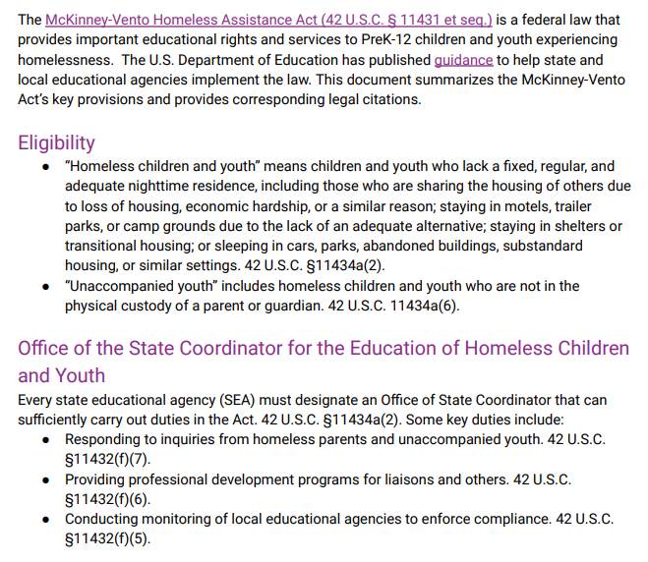
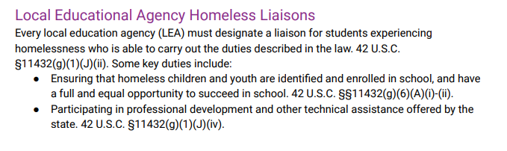
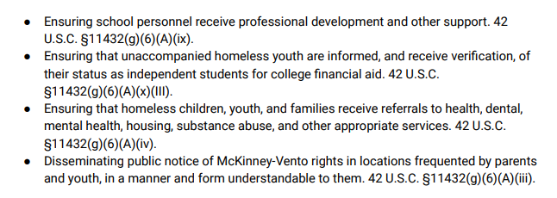
McKinney –Vento Act

Slide 16
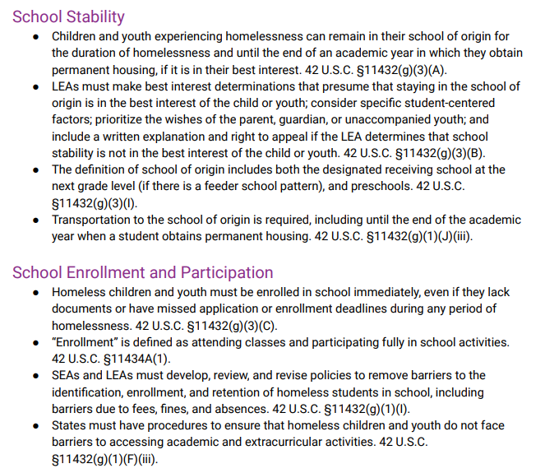
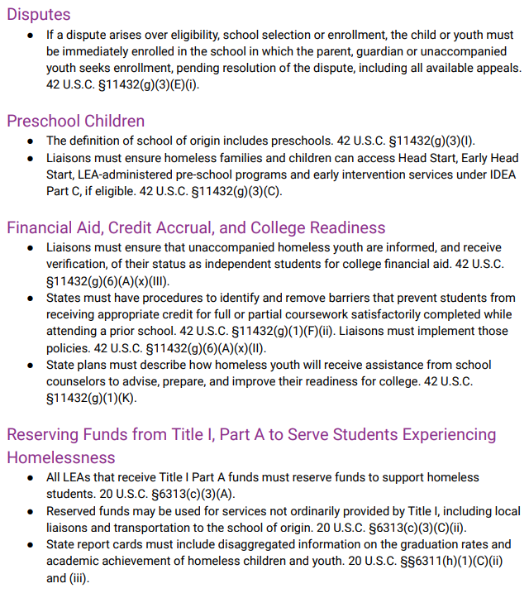
McKinney-Vento Act

Slide 17
Diversion
Agencies must apply for diversion funds.
Currently, Catholic Charities Diocese of Metuchen (CCDOM), Puerto Rican Association for Human Development (PRAHD), and Garden State Home are recipients of diversion grant funding.
If your client has rental arrears and is at risk of eviction, they can contact these organizations to apply for assistance. The funds are limited and are usually depleted by Spring/Summer.
You can also advise the client to reach out to their friends/family and local churches to help them acquire funds for a security deposit, first month’s rent, and rental arrears.

Slide 18
Making Shifts Happen: Coordinated Prevention
Coming Home is currently leading a new initiative called Coordinated Prevention. Our goal is to permanently reduce overall homelessness through targeted assistance that reaches people who are likely to become homeless, reduces or eliminates a person’s housing crisis, and is rooted in evidence-based, data-informed research and prioritization that utilizes data-driven indicators.
We want to strengthen our connection to Middlesex County community partners and ensure that everyone is aware of the existing resources for preventing and ending homelessness. Case Managers & Housing/Access Navigators have direct contact with families who are precariously housed, living in a place not meant for habitation, in emergency shelter, or self-paying for motel. We don’t know who is precariously housed, unless they reach out for help, so we are relying on you to guide them on how to enter the homelessness system (call 211 or visit an Access Site).
To interact with Making Shifts Happen, please connect with Jenna Colagiacomi, Director of System Programs. Jenna.Colagiacomi@co.Middlesex.nj.us , 732.745.8862

Slide 19



Making Shifts Happen – Coming Soon!
In 2026, we will be launching a funded (by Middlesex County) Eviction Prevention Program.
In 2026, we will be launching a funded (by Middlesex County) Community-Based Case Management Program.
We are working on a database of Middlesex County community resources, that will be shared with the CoC! Through Google Classroom and/or Civic Roundtable.
We are building a network of temp agencies, so that we can start referring clients to direct contacts, to streamline the employment process (if the client is ready, willing, and able to work).

Slide 20
Coordinated Assessment

Slide 21
Connecting with the Coordinated Assessment Team
The Housing Support Team or Agency Case Manager should include the Coordinated Assessment Team on correspondence for the referral to the HST.
Agency Case Managers should confirm with the CA Team that Coordinated Assessment has been received and is still active for the client they need to refer. If not, they need to submit one that is true for today. If yes, submit the referral and copy the CA Team on the email
If the HST receives a referral and is not sure the client has an active CA, they should reach out to the CA Team to confirm.

Slide 22
The Coordinated Assessment Tool
The Coordinated Assessment Tool is used to Assess and Prioritize Individuals/Families experiencing HUD Homelessness. The Assessment is used to determine the appropriate housing solution for the homeless individual/family.
Clients are Prioritized for housing solutions based on their length of homelessness and the severity of their needs.
Clients are Referred for a housing resource based on their prioritization and other eligibility criteria once a resource becomes available.
Who should complete it?:
The client may NOT fill out their own CA!
Emergency shelter staff
Case manager
Social worker
DCP&P case worker
MCBOSS
For whom should it be completed?:
The individual/family in a place not meant for habitation
Those in a motel placement paid for by agency/church
The individual/family in a shelter
HUD Homeless criteria on slide 9

Slide 23
Next Steps: after submitting a Coordinated Assessment Form
Email the completed Assessment to coordinated.assessment@co.Middlesex.nj.us
The CEA Team will review & score the Assessment. The Score & Summary will be sent to the case manager(s).
Next Steps will be noted on the Summary. Client will be added to the By-Name-List (BNL)
Client will be referred for a housing opportunity or resource when available based on eligibility criteria.
Label the Coordinated Assessment. For example: J. Doe

Slide 24
Next Steps – when an opportunity arises
Timing is critical. When a housing opportunity presents itself, you and the individual/family you are working with MUST be “ready to go”.
Ready to go:
Birth Certificates (for all Household members)
Social Security Cards (for all Household members)
Paystubs (at least 2 months worth)
SS Award letter
TANF/GA Award letter
Bank Statements (at least 2-3 months worth
Basic supporting documents are listed at the end of the CA packet

Slide 25
Next Steps – when an opportunity arises
Timing is critical. When a housing opportunity presents itself, you and the individual/family you are working with MUST be “ready to go”.
Ready to go:
This email is NOT to be forwarded to the client. YOU ARE to assist them.
This opportunity is NOT guaranteed. They still need to complete the application process.
If/when approved, assist with locating a Security Deposit. CA Team will refer if funds are available through other programs.
Consistently attend Case Conference Calls to discuss cases. The community can/should work together for resources.

Slide 26
Housing Support Team at CCDOM
The Housing Support Team consists of a Property Engager and Housing Placement Liaison.
The Property Engager will build, maintain and keep current inventory of low barrier housing units of all sizes and landlords agreeing to rent to clients of MCHC3 agencies.
The Housing Placement Liaison (HP Liaison) will receive referrals from Agency Case Managers of clients who have gone through the Coordinated Assessment system and been approved for rental assistance or have the ability to self-pay. The referral will include a listing of the client’s needs and wants. The HP Liaison will review the Client Agreement with the client and obtain his/her signature. The Housing Support Team will identify available units appropriate for the client. If no such units are available in the inventory, the Property Engager must make best efforts to find additional units that match the client’s needs.

Slide 27


Coordinated Assessment Leadership Team
We want to ensure we are continuously improving our Coordinated Assessment Tool, so we have a CALT that will resume meeting once per quarter, to evaluate how efficient and equitable the tool is for our clients and easy to use for our case managers.

Slide 28

Referrals
from Coming Home

Slide 29
MCBOSS
https://middlesexsocialservices.com/
If someone is referred to the Board of Social Services, they need to visit the website or the office to complete the applications necessary for the assistance they’re looking for.
Those who have zero income, SSI, GA or TANF are referred to MCBOSS.
If they have zero income, they should apply for GA/TANF and SNAP.
EA is Emergency Assistance. This is could be motel placement or placement into a shelter bed that is reserved for MCBOSS. They MUST have active GA, TANF or be receiving SSI for EA eligibility.
Definitions
SSI – Supplemental Security Income
GA – General Assistance
TANF – Temporary Assistance for Needy Families
SNAP – Supplemental Nutrition Assistance Program (food stamps)

Slide 30
Referrals
Referrals are made to individuals either directly or indirectly after a full intake has been completed. Some of the main referrals we provide are below but are not limited to these options.
PATH
Shelter
External Agencies
Social Service Homeless Case Management (SSH)

Slide 31
Referrals - PATH
The Project for Assistance in Transition from Homelessness (PATH) is designed to assist mentally ill individuals who are homeless. The project provides assistance securing entitlements, mental health treatment and housing. Services are provided to clients in the community in train stations, hospital emergency rooms, shelters and soup kitchens, and include outreach case management for homeless individuals with serious mental illness.
ELIGIBILITY CRITERIA:
Services are available to those who have severe, persistent mental illness and who are homeless or on the verge of homelessness. Clinical diagnosis of an accepted DSM illness is basis for diagnostic criteria. Services were provided for one year with the goal of linkage to mental health services and housing opportunities. in securing entitlements, mental health treatment,

Slide 32
Referrals - Shelter
Ozanam Women and Family Shelter
The family shelter provides shelter for 16 single women and 26 families. Services include temporary and emergency lodging, meals, assistance with housing, employment and children's educational placement, case management, and referrals. While living in the shelter, program residents work with case managers to improve their earning capacity and obtain permanent housing.
Ozanam Inn Men’s Shelter
The Ozanam Inn provides temporary and emergency lodging, meals, assistance with housing and employment, case management, and referrals to 40 homeless men.

Slide 33
Shelter
Middlesex County activates the Code Blue Emergency Warming Center at 6 Kirkpatrick Street, New Brunswick when the temperature reaches 32 degrees or below OR when the wind chill is below 0 for more than 2 hours. The doors open at 7pm, close at 9pm and people are allowed to stay until 7am.
This doubles as Code Red during the summer months.
The Interfaith Rotating Shelter is operated by a group of churches in New Brunswick. Each church provides food and shelter one week at a time, and is staffed by church member volunteers.
This shelter operates from December to the beginning of March.
The Rotating Shelter is for Men ONLY and they must be on the shelter waiting list that Coming Home maintains.

Slide 34
Referrals – Social Service Homeless Case Management (SSH)
Eligibility:
Must be a resident of Middlesex County.
Currently homeless or at imminent risk of homelessness.
Ineligible for County Prevention Assistance.
Have an income other than TANF, GA, or SSI.
Not receiving services from MCBSS or ineligible for MCBSS services, regardless of income.
Interested in securing employment for self-sufficiency.
Receiving GA or TANF but exhausted EA housing benefits and seeking employment.
Not more appropriately served by mental health or addiction professionals (e.g., PATH).
Ineligible for Veteran case management programs.
Not already receiving community-based case management services from another agency.
Not residing in a year-round homeless shelter, domestic violence shelter, MCBSS hotel placement, incarcerated, or in an inpatient mental health or drug treatment program.

Slide 35
Case Managers Collaborative
Case Managers meet once a month, on the second Friday, at 11am.
We try to have a guest speaker for each meeting!
This is an opportunity for Case Managers to chat and learn about available resources.
Everyone is encouraged to bring flyers/brochures regarding their own programs and any relevant events they’ve found.

Slide 36
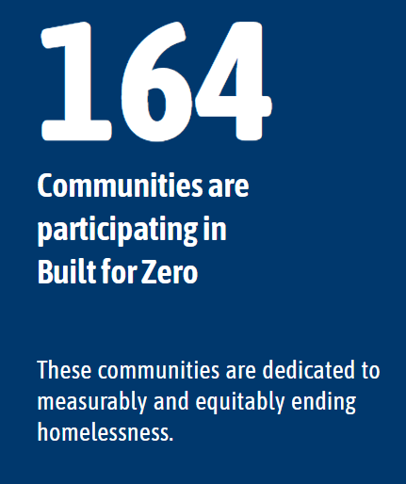
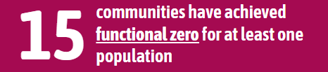
Built for Zero: A Movement to Measurably and Equitably End Homelessness
Built for Zero is a movement, a methodology, and proof of what is possible. Over 100 cities and counties have committed to measurably ending homelessness for entire populations. Using data, these communities have changed how local homeless response systems work and the impact they can achieve. Together, they are proving that we can build a future where homelessness is rare overall and brief when it occurs.

Slide 37
By-Name-List (BNL)
A comprehensive, continuously updated list of every person experiencing HUD Homelessness in a community.
Everyone who has an appropriate and acceptable CA is added to the By-Name-List. Can also be called a Prioritization List.
Look at it as a waiting list. All of these individuals/families are awaiting a referral to an available housing resource/opportunity.
This helps us to refer appropriately based on the criteria of each resource/opportunity.

Slide 38
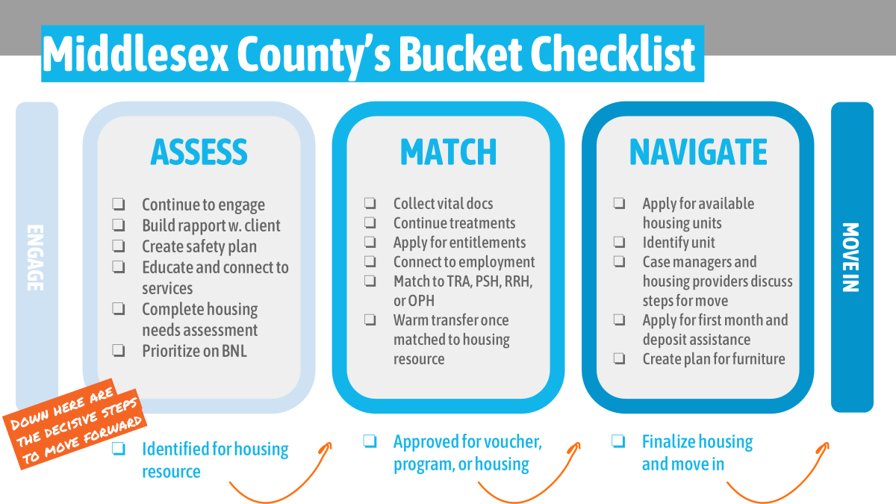
Referrals - TRA
Temporary Rental Assistance (TRA) is a short-term financial assistance program provided by the Middlesex County Board of Social Services (MCBOSS). These individuals/families need to apply for assistance through MCBOSS. They are usually already receiving GA or TANF and would NOT be eligible for RRH. This also includes those who are receiving EA placement
Types of Financial Assistance include:
Short Term Rental Assistance
Security Deposits
1st Month’s Rent

Slide 39
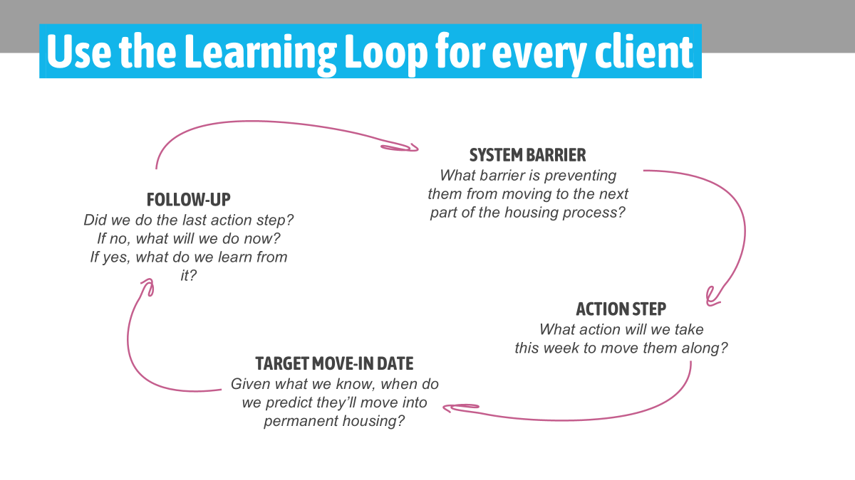
Case Conferencing
Monthly check-in calls as a community to discuss individuals/families that are on the By-Name-List (BNL).
The clients discussed MUST have a Coordinated Assessment.
We share resources that will benefit one another.
These calls are held monthly on the 4th Tuesday via Teams.

Slide 40
Case Conferencing
General
Veterans
Domestic Violence
We review everyone who is on the BNL and connected to a Case Manager.
Case Managers share updates about their clients and can ask for advice.
We follow the Built For Zero framework of using the “bucket system” to track the housing process for each client.
Soldier On leads the Veterans Case Conferencing.
Only Veteran clients are discussed.
Case Managers share updates about their clients and can ask for advice.
By Name List is separate from CoC BNL and is shared with the Bringing Veterans Home initiative, led by the state.
Due to safety concerns, DV victims are discussed separately, and names are not disclosed.
Case Managers share updates and can ask for advice.

Slide 41
Case Conferencing
DCP&P
At Risk
Coming Home meets with DCP&P Case Managers to discuss clients and share updates on families’ progress towards getting housed.
Any families that have not previously called 211, will be offered the option of being on the Shelter Waitlist and assessed for resources and referrals.
Through the Making Shifts Happen Coordinated Prevention Initiative, we will be launching this soon!
We will be offering an opportunity for Case Managers/Community Organizations the opportunity to discuss the next steps, to prevent clients from becoming homeless.

Slide 42
PIT (Point-In-Time Homeless Count)
Coming Home coordinates the Middlesex County Annual Point in Time Count (PIT) every January. PIT is a snapshot of the number of people experiencing homelessness in a community on a single night.
The Head of the Household is asked questions on the PIT survey about themselves and each member of the household.
You will be in direct contact with the individuals/families that are considered homeless and will have the opportunity to help us have an accurate count.
We work with MCBOSS to contact all individuals/families staying in motels paid for by MCBOSS. We also work with the shelter staff to survey the residents. And we do street outreach as well.
Families that are self-paying at motels or are precariously housed would not be counted in the survey.
If you are aware of a family living somewhere not meant for habitation (ex: living in their car), please do a PIT survey, if the family agrees to participate.
To participate in PIT 2026, please connect with Jenna Colagiacomi, Director of System Programs. Jenna.Colagiacomi@co.Middlesex.nj.us , 732.745.8862

Slide 43

The way to get started is to quit talking and begin doing.
Walt Disney

Slide 44
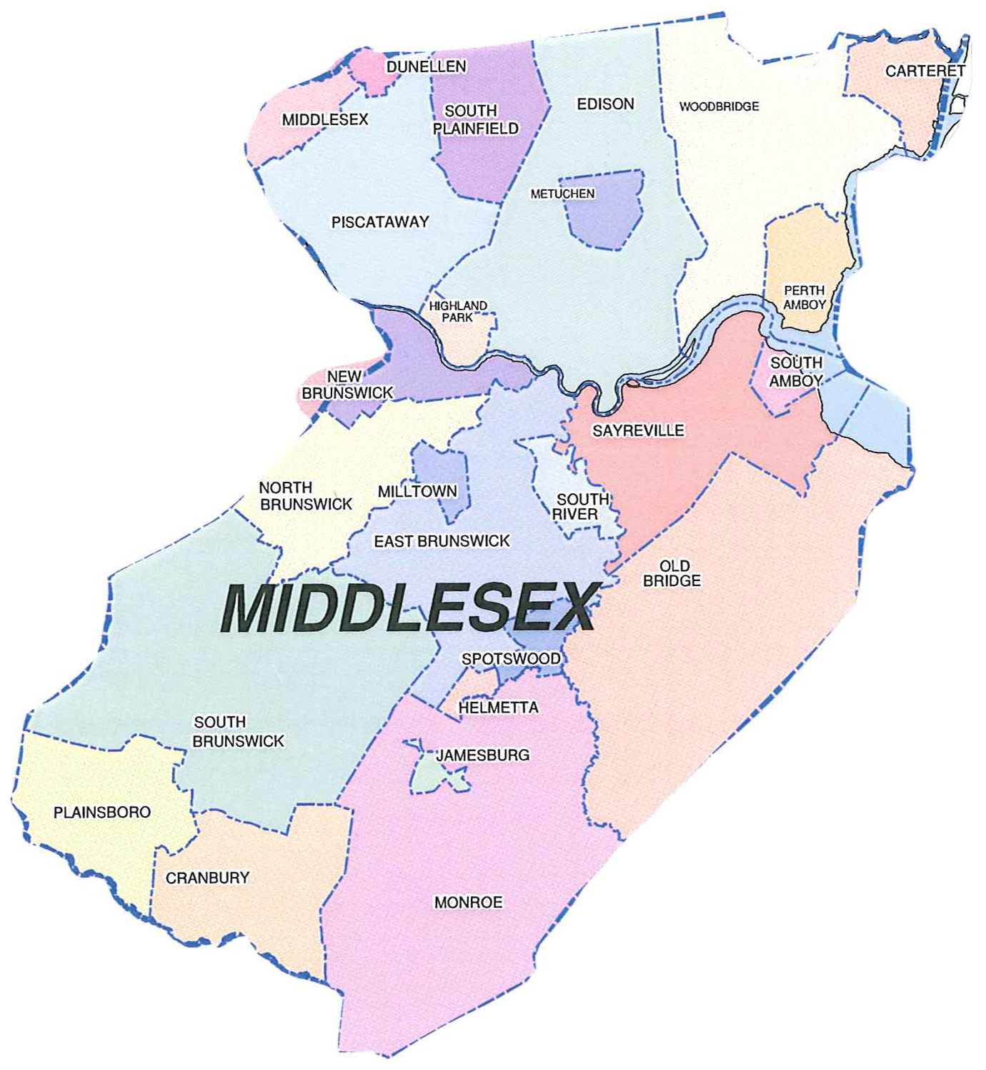
CoC Partnerships
Who we are

Slide 45

Triple C Housing
Triple C Housing provides affordable, supportive housing for individuals and families with special needs including those with a mental health diagnosis, at risk of homelessness, survivors of domestic violence, and veterans, many of whom are managing co-occurring disabilities, health conditions, or income insecurity.
Our Supportive Housing Approach: - Housing First / Shelter-First: Stability before treatment or employment - Tenant-Centered Services: Supports tailored to individual needs and goals - Community Integration: Partnerships with developers, healthcare systems, and local organizations
Implementation Model: - Community Support Services (CSS): Intensive, Medicaid-billable behavioral health supports with weekly goal-oriented case management - Generic Supportive Services: On-site Service Coordinators offering education, resource navigation, and community connections for more independent tenants

Slide 46
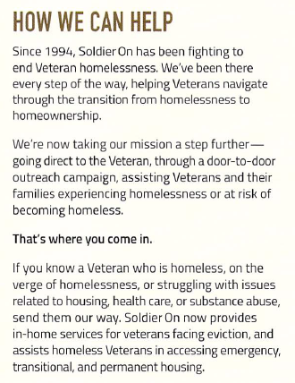
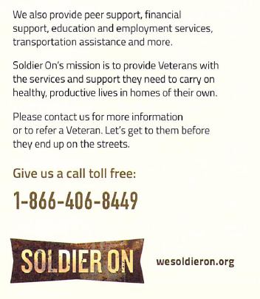
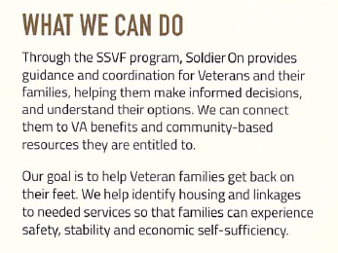
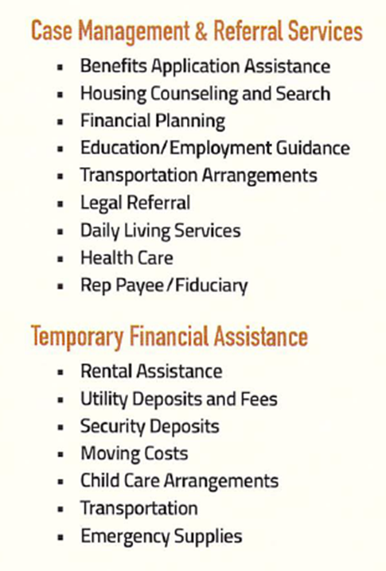
Soldier On

Slide 47
There is nothing more important than a good, safe, secure home.
Rosalynn carter

Slide 48




Everybody’s Getting Housed!
Cassandra jones | Cassandra.jones@co.Middlesex.nj.us |

